Slide 1
A Demographic Snapshot of Austin
presentation to the Rocky Mountain Institute
Mobility Transformation program
August 12, 2015
Ryan Robinson
City Demographer
Planning & Development Review Department
Notes:
1

Slide 2
Takeaways
A continuation of robust job and population growth.
Diversification may be slowing.
A massive collapse in Austin’s overall affordability is well underway.
Austin is still a mecca for millennials but is also now an emerging destination for retirees.
Stubborn socioeconomic separations may be getting worse.
A Demographic Snapshot of Austin
Presentation to the RMI, Mobility Transformation
Ryan Robinson
City Demographer
City of Austin
Notes:
2
2

Slide 3
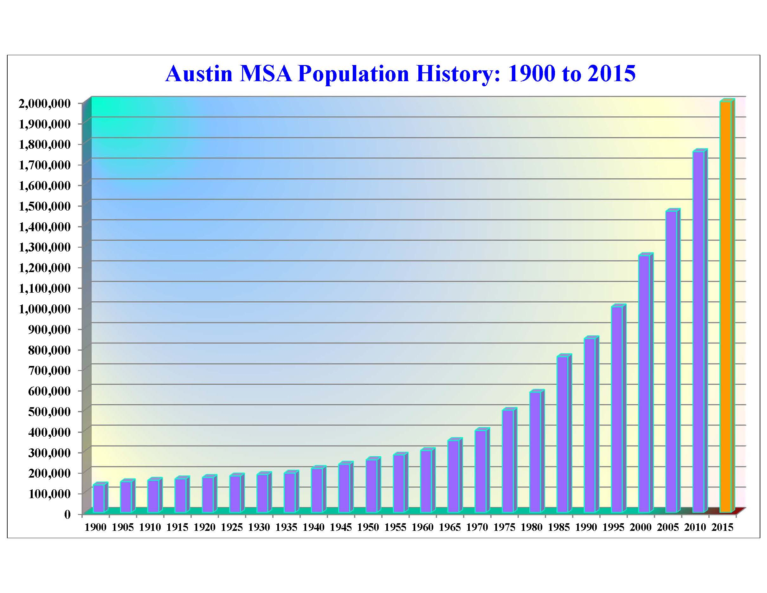
Austin is an open city.
Austin is a tolerant city.
Austin is a magnet for entrepreneurs.
Austin is a well-educated city.
Austin is an international immigrant gateway.
Austin’s cultural vibrancy has
become one of our biggest
economic development engines.

Slide 4
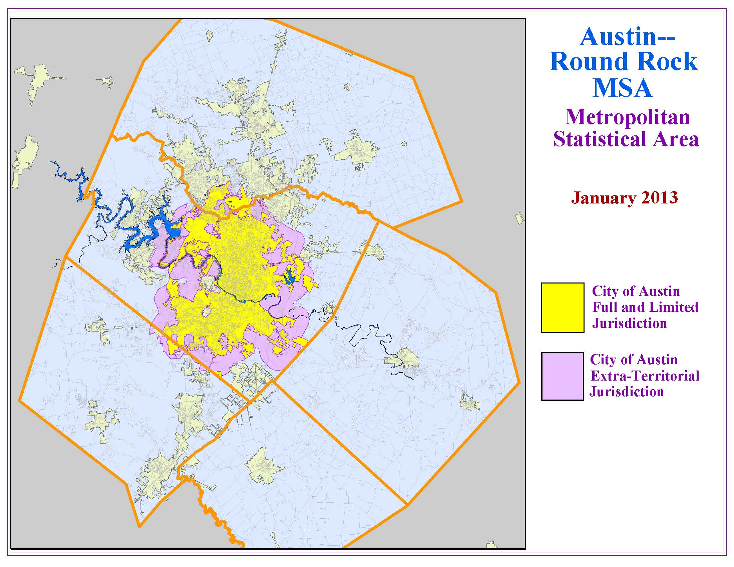
Williamson
Travis
Bastrop
Hays
Caldwell

Slide 5
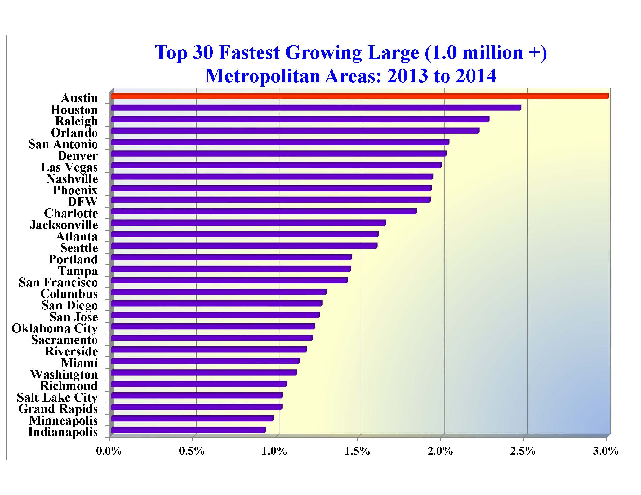

Slide 6
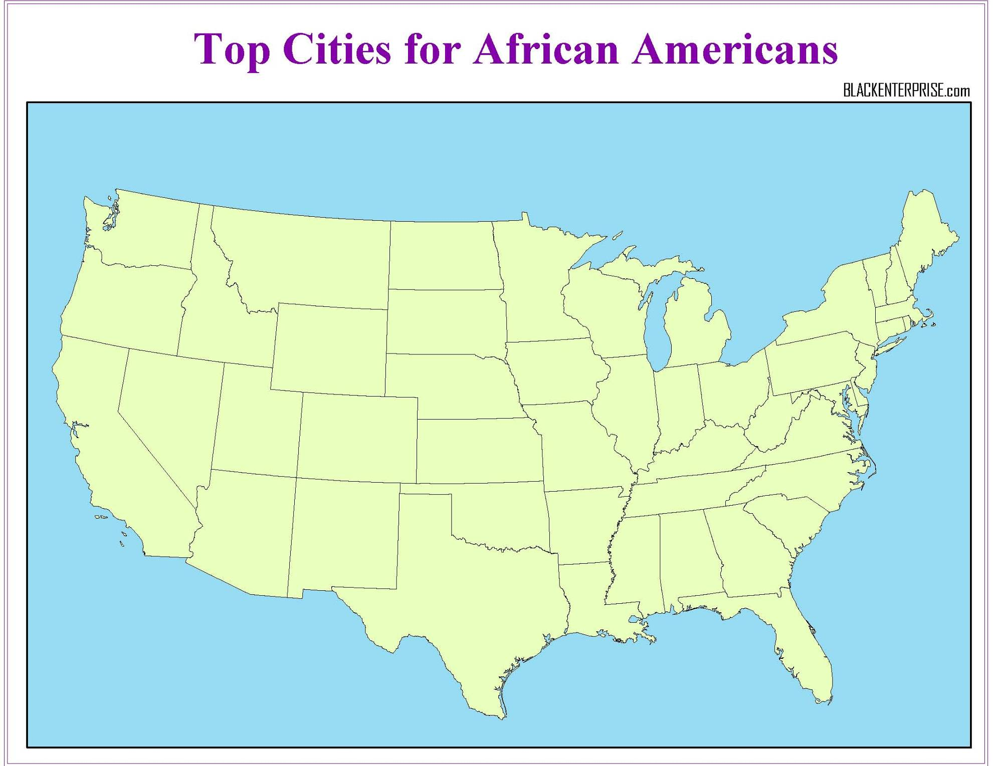
10 Fastest Growing Metro Areas, 2013 to 2014
Denver
Las Vegas
Raleigh
Nashville
Phoenix
DFW
Austin
Houston
San Antonio
Orlando

Slide 7
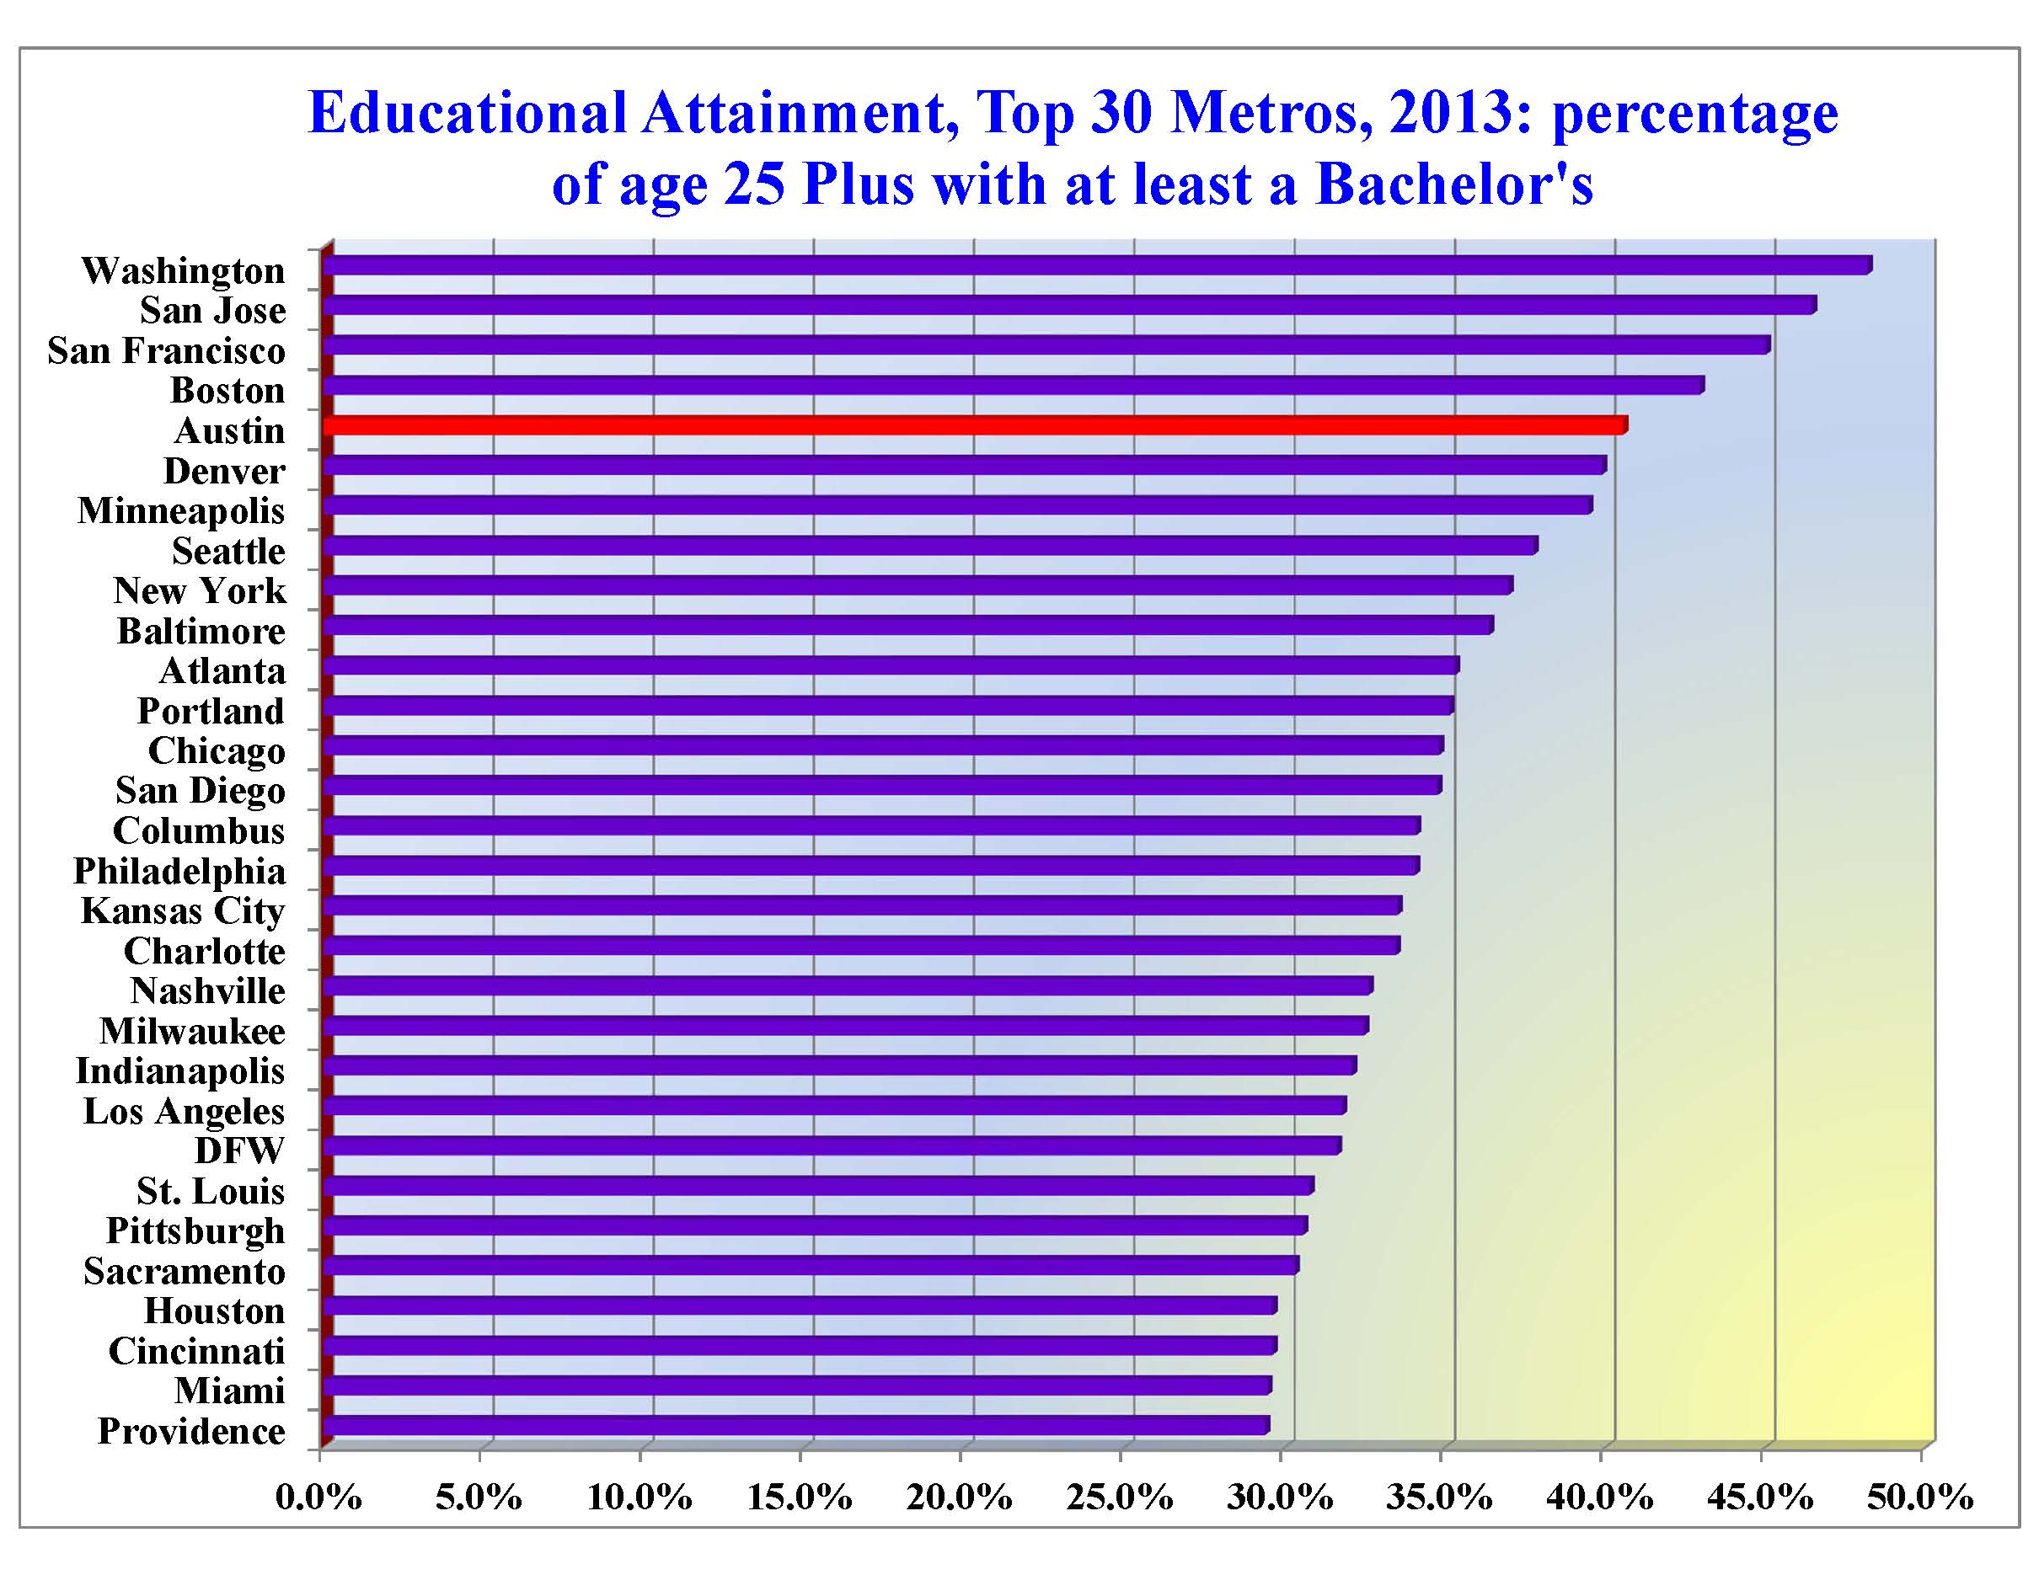
5th
Source: American Community Survey, 2013 1-year estimates, Table B15003.

Slide 8
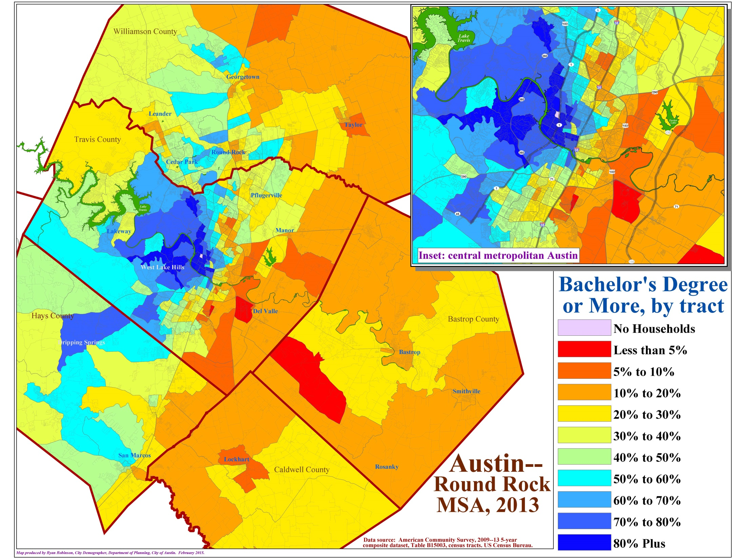

Slide 9
A Demographic Snapshot of Austin
…Job growth is what it’s all about…
metropolitan Austin job creation is running at about 3.0% (that’s roughly 30K new jobs each year) .
Forbes indicated in 2014 that Austin’s economy had the “most momentum of any metro in the country.”
Unemployment hovers around 4.0%, state of Texas at 4.6% and the nation at 5.6%.
Almost all Sectors are expanding…but most current growth coming from Services, Logistics and Construction.
Notes:
9
9

Slide 10
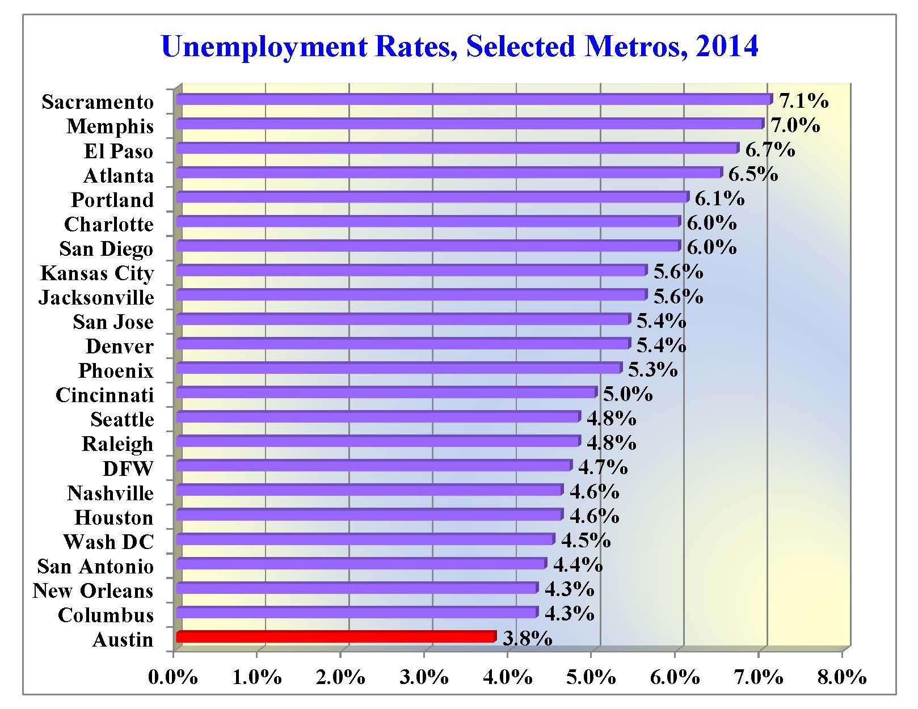
Unemployment Rates
as of Dec 2014,
BLS

Slide 11
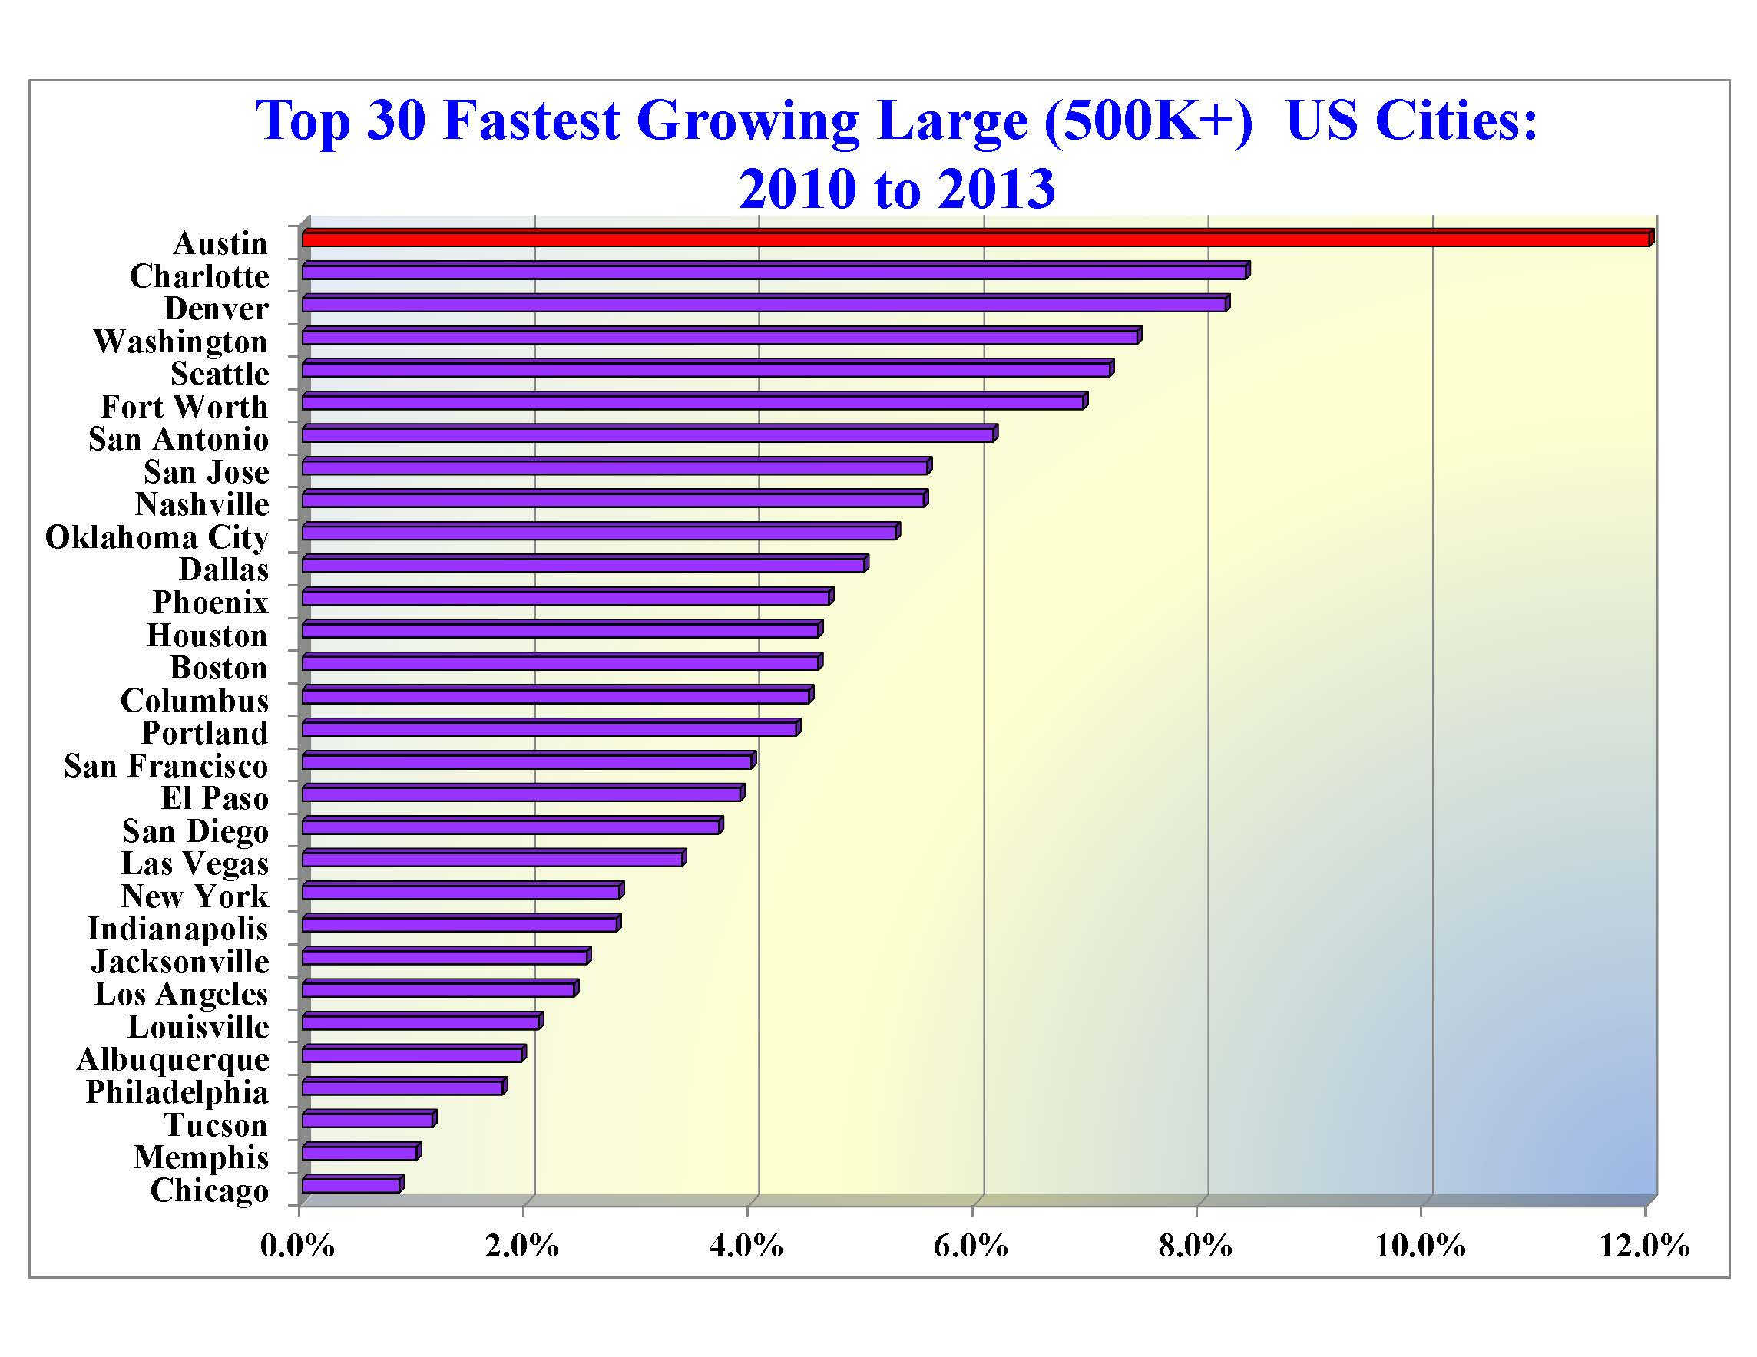
Austin emerged from the
Great Recession as a member
of an elite but small group
of cities that has now surged
ahead of most other cities…

Slide 12
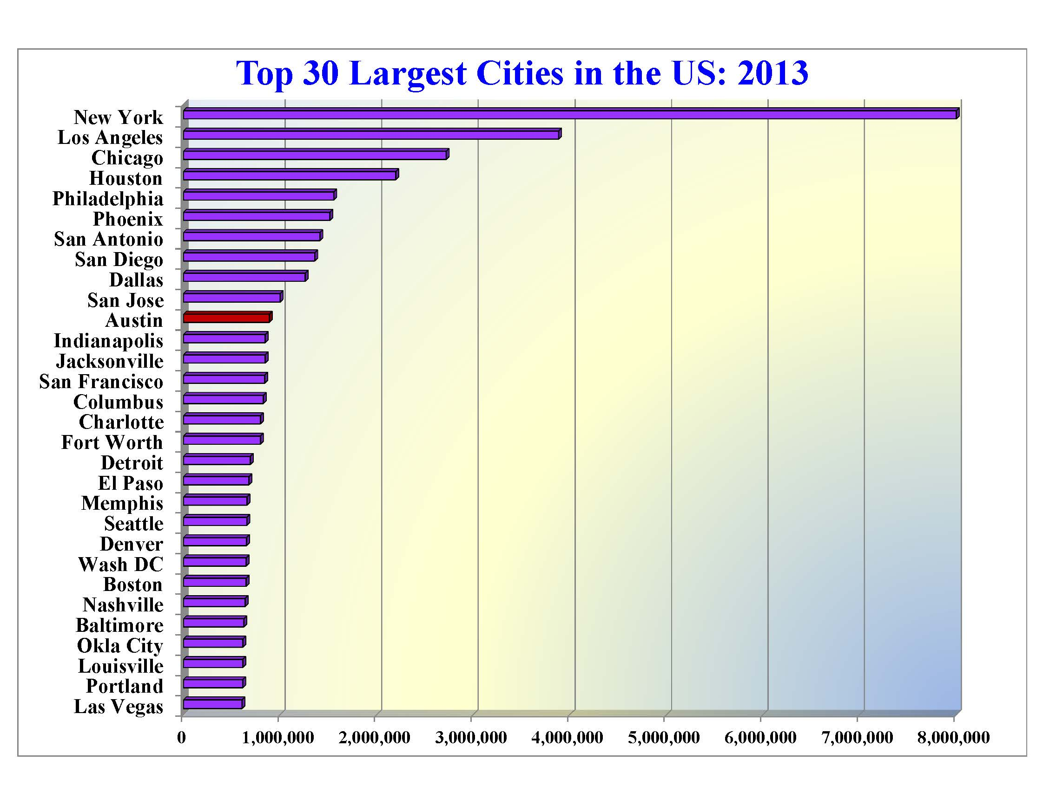
27th in 1990
11th
16th in 2000
14th in 2010
11th in 2013
10th by 2025…

Slide 13
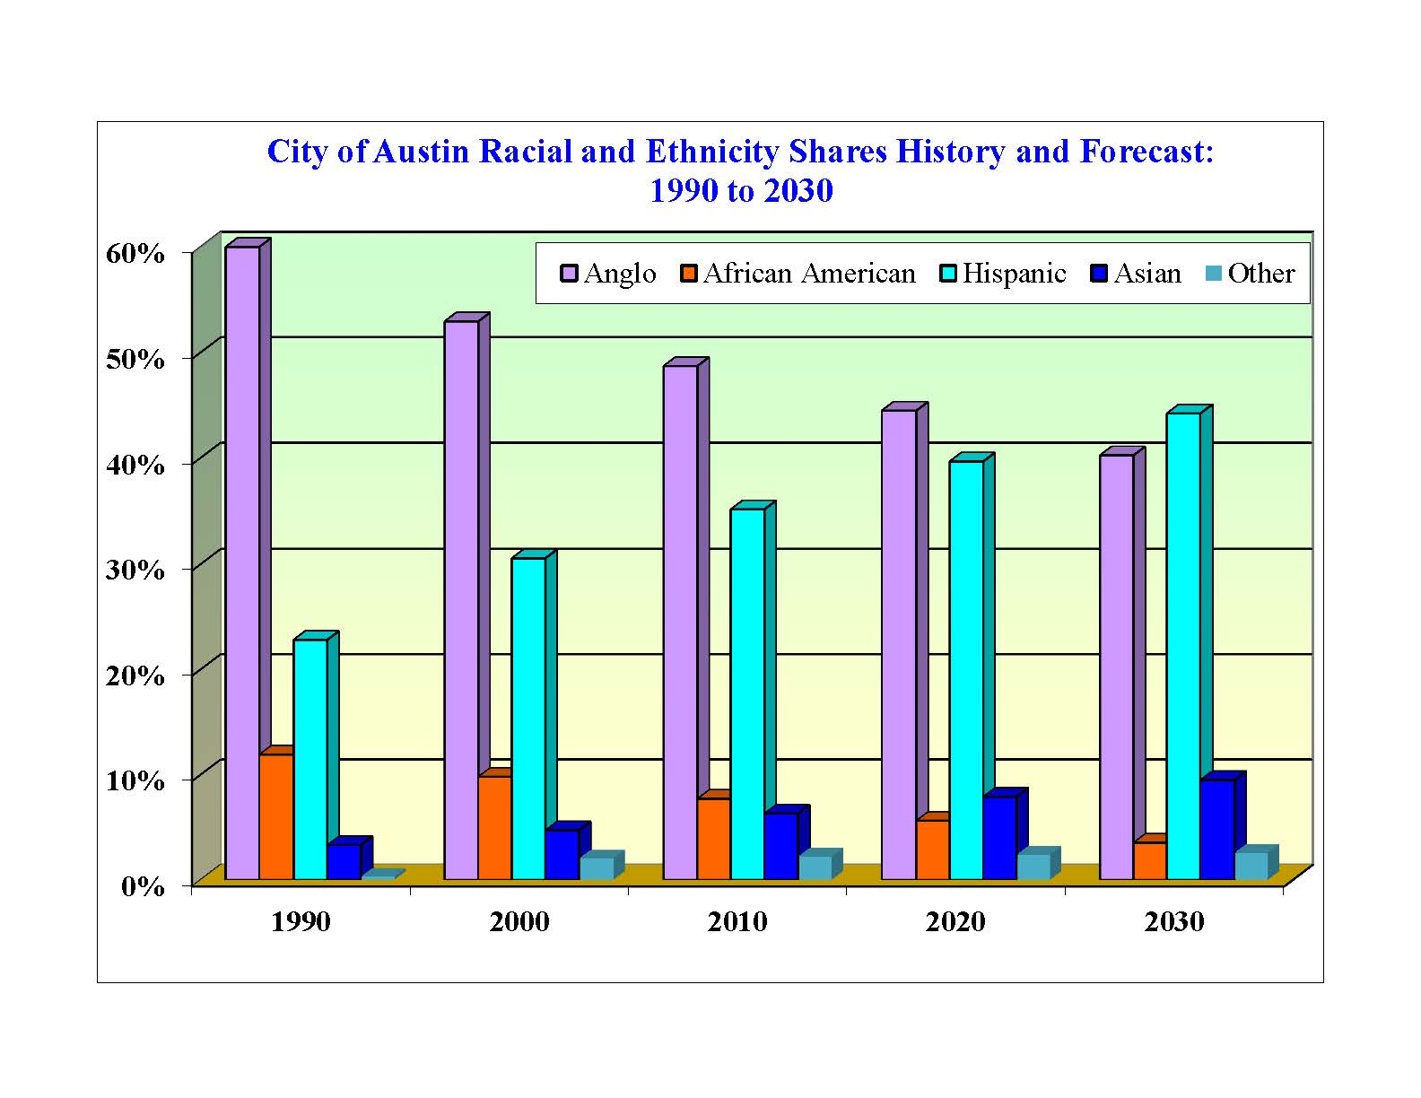
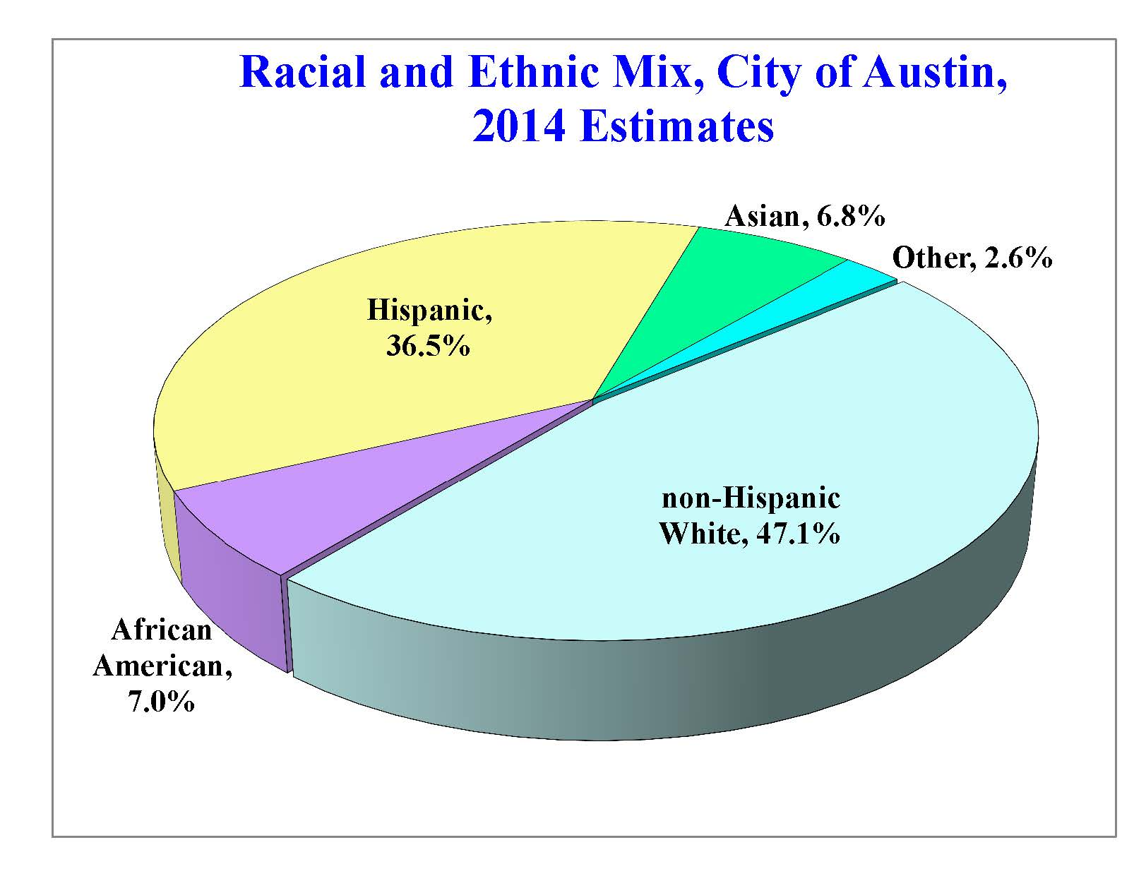
A Demographic Snapshot of Austin
A continuation of robust job and population growth.
Diversification may be slowing.
Notes:
13
13

Slide 14
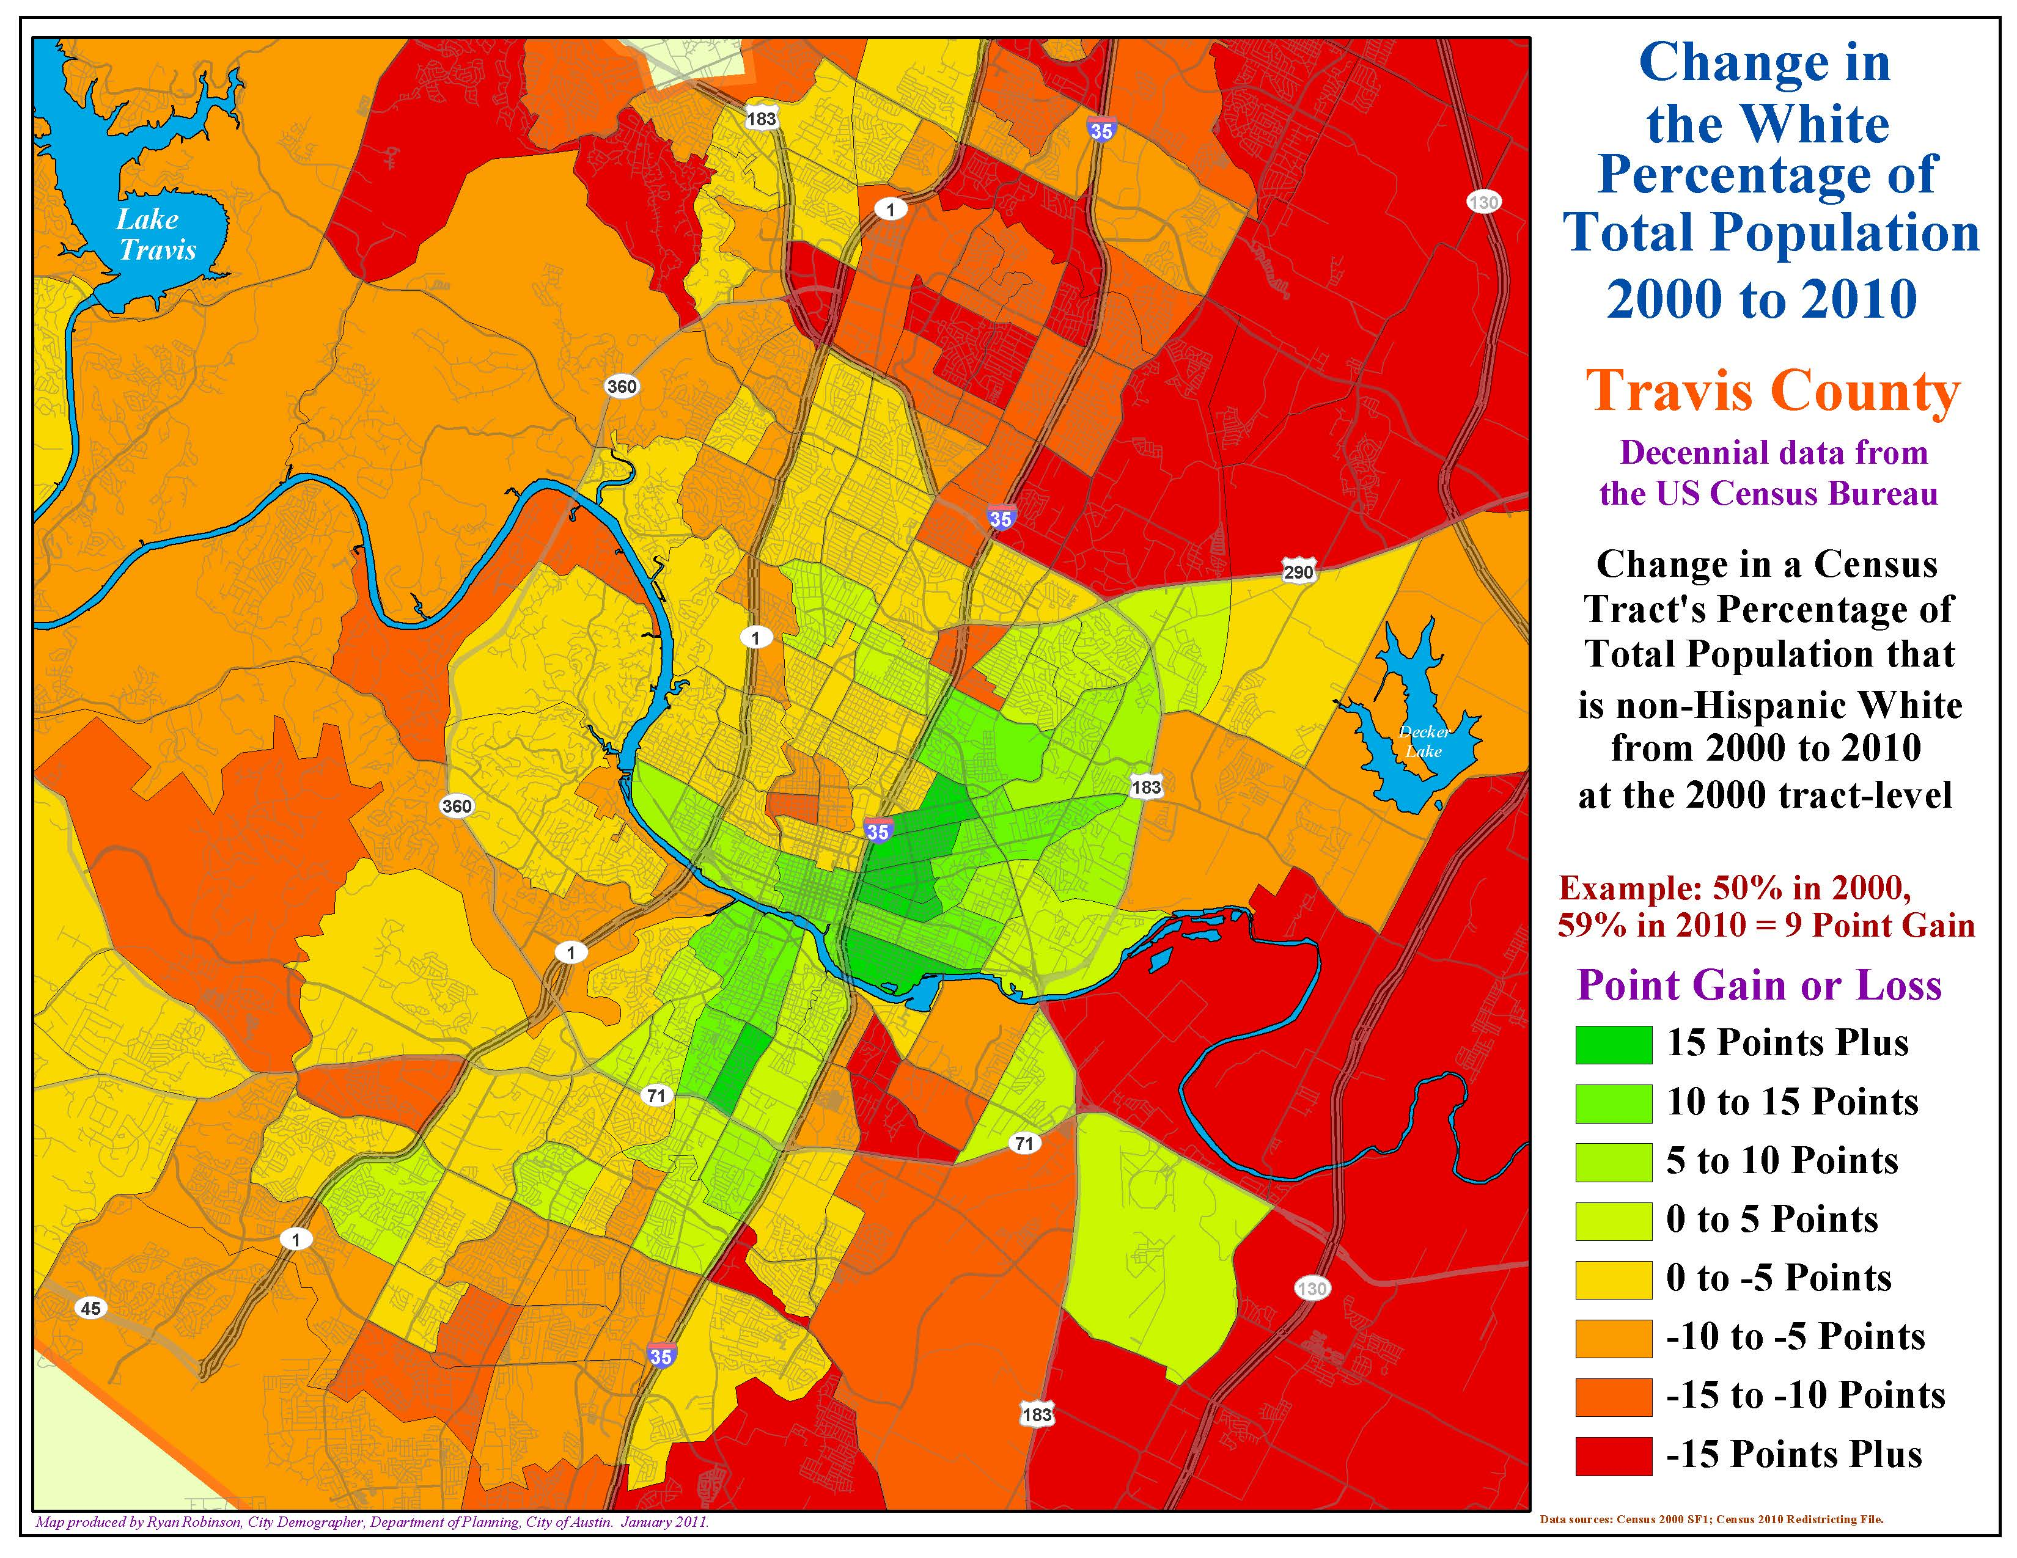

Slide 15
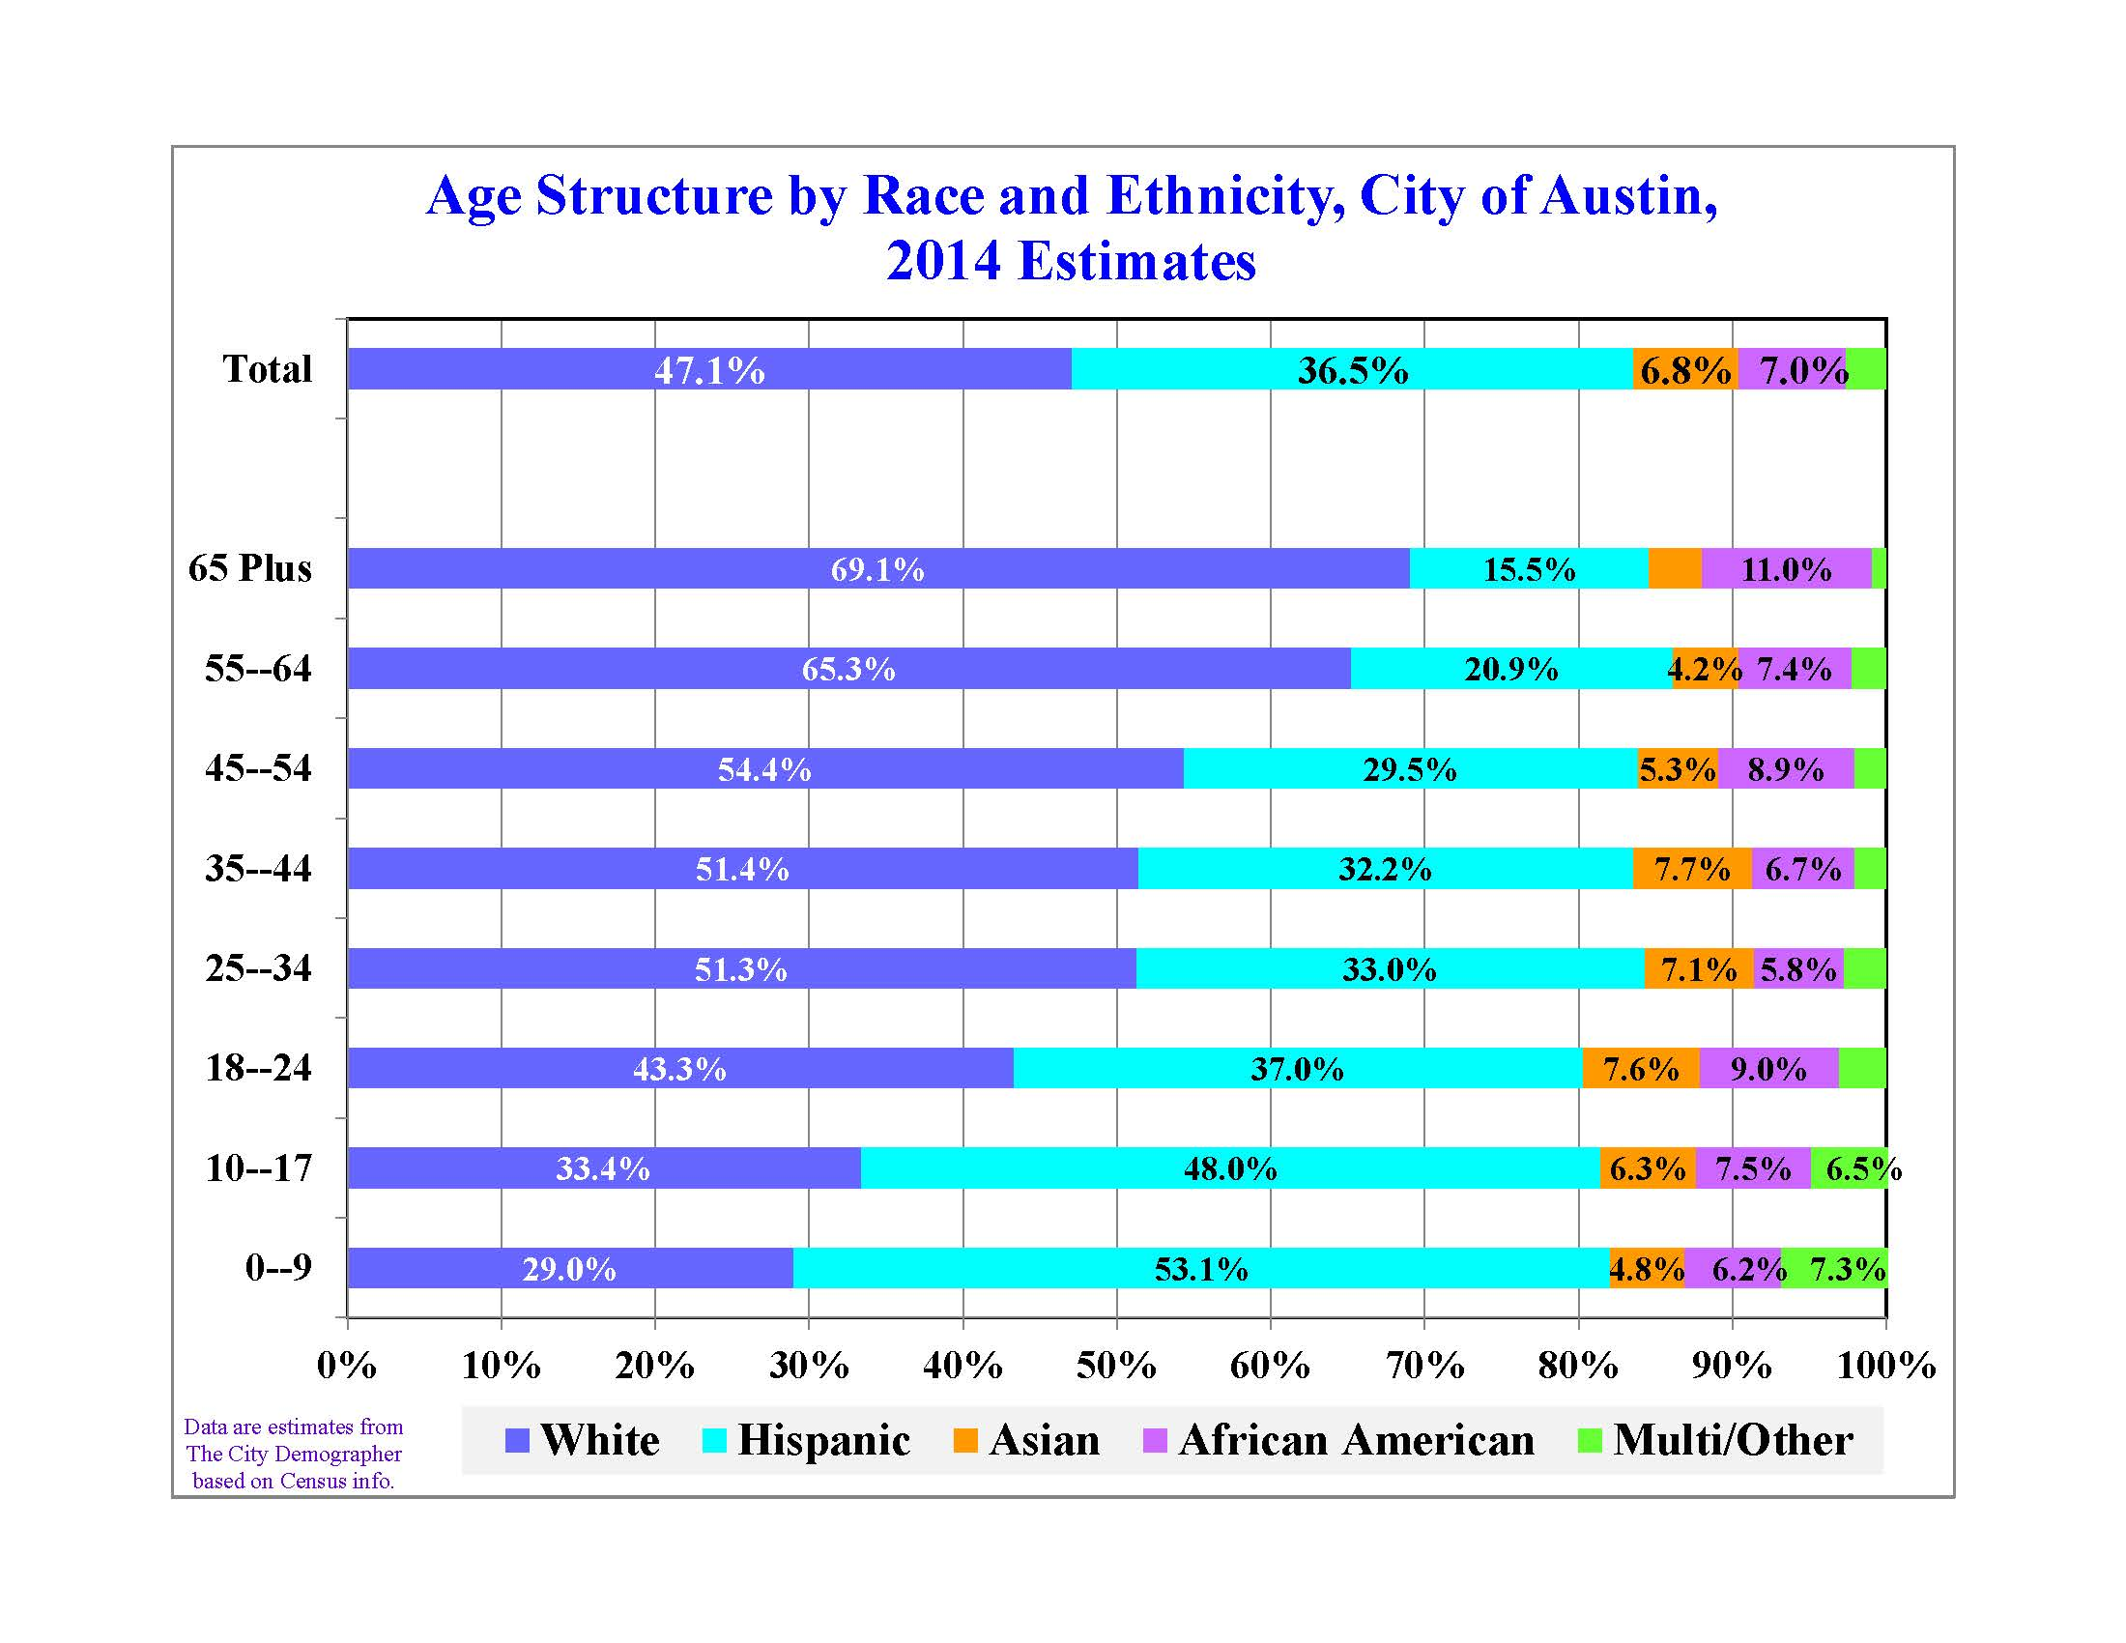

Slide 16
A Demographic Snapshot of Austin
A continuation of robust job and population growth.
Diversification may be slowing.
A massive collapse in Austin’s overall affordability is well underway.
Notes:
16
16

Slide 17
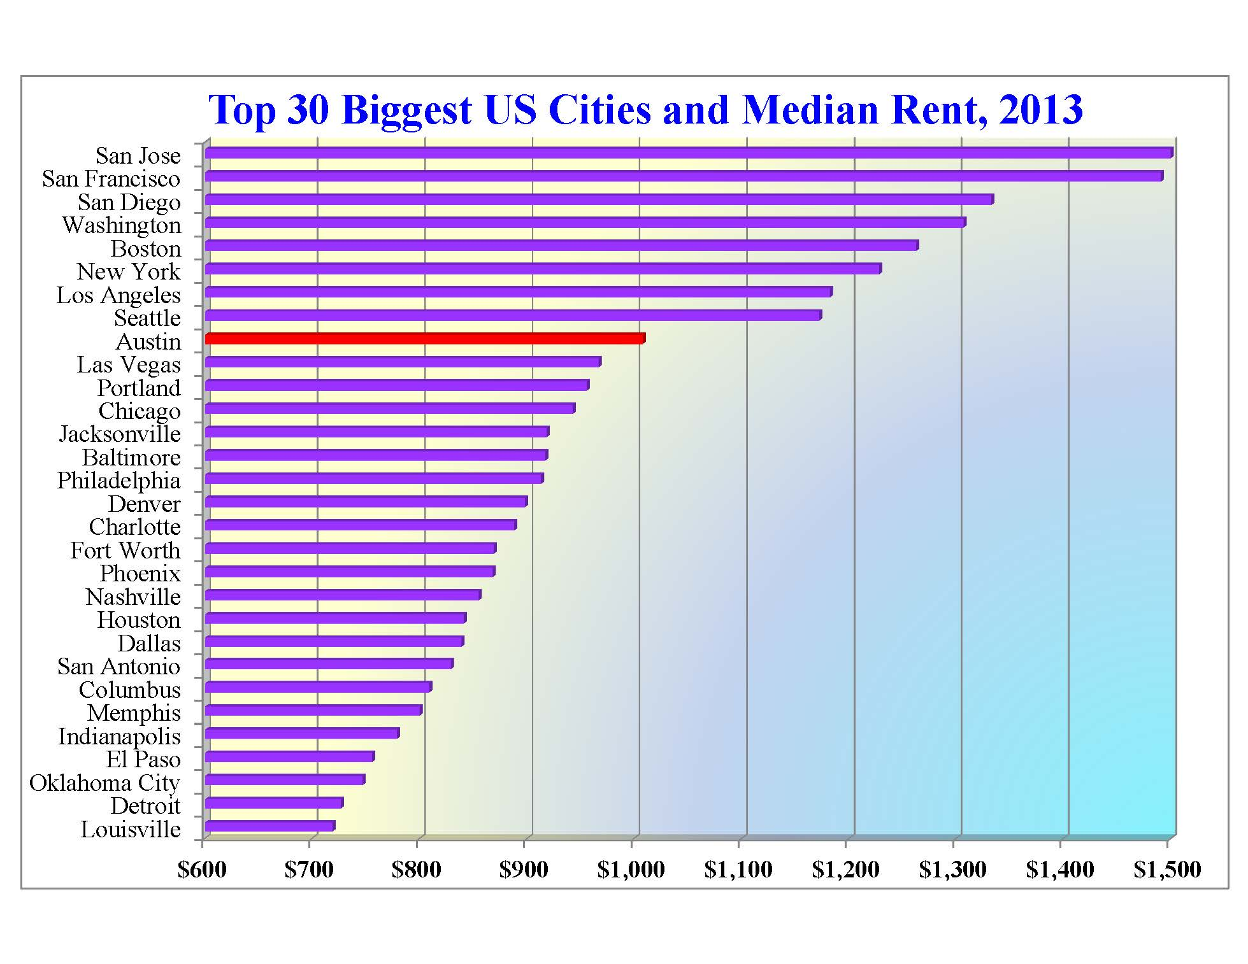
9th
Source: 2011 US Census ACS 1-year estimates, Table B25064

Slide 18
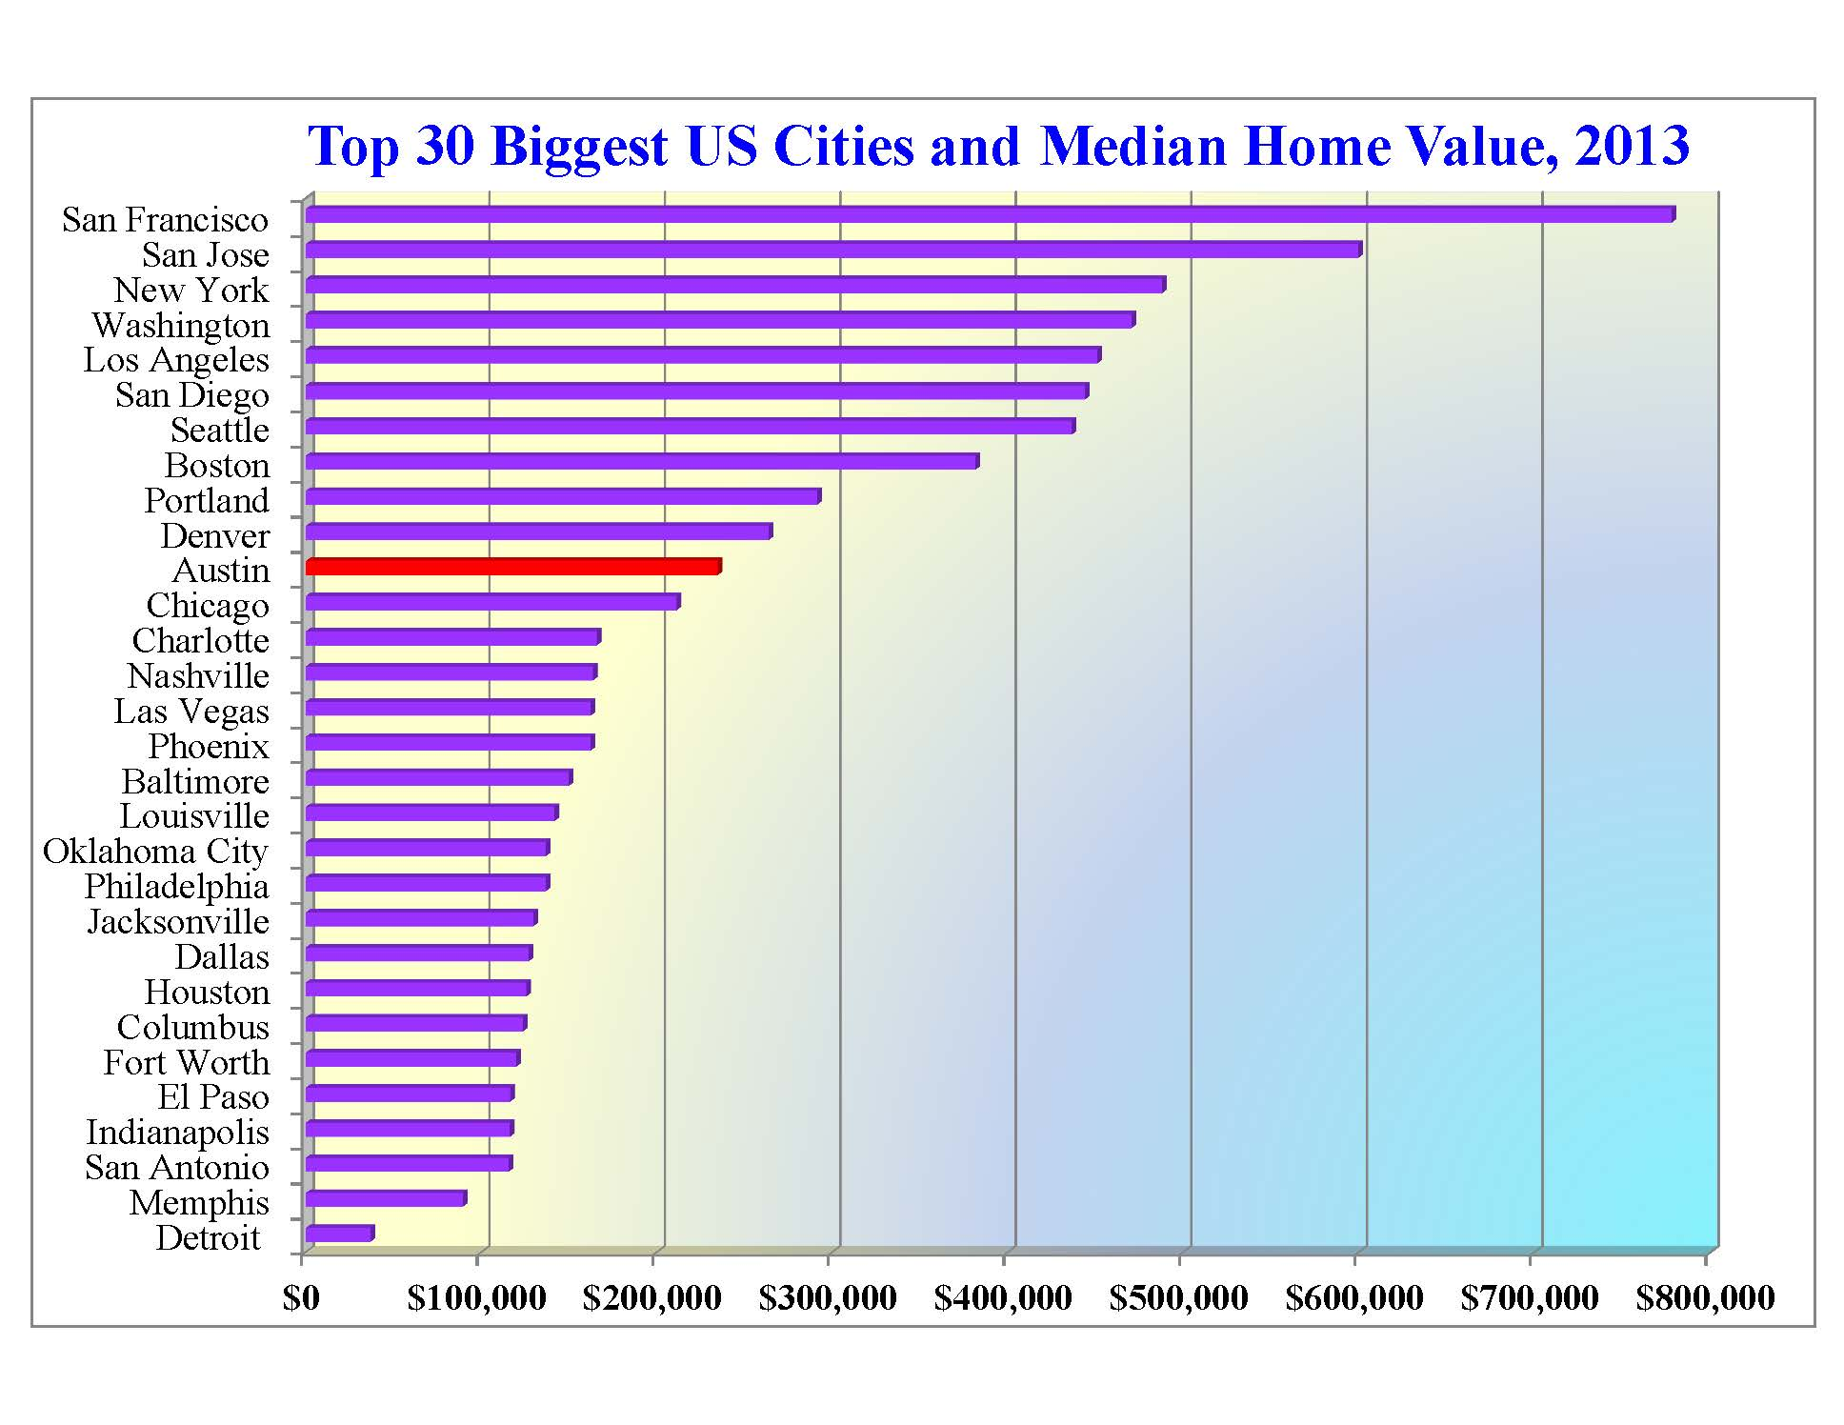
11th
Source: 2013 US Census ACS 1-year estimates, Table B25091

Slide 21
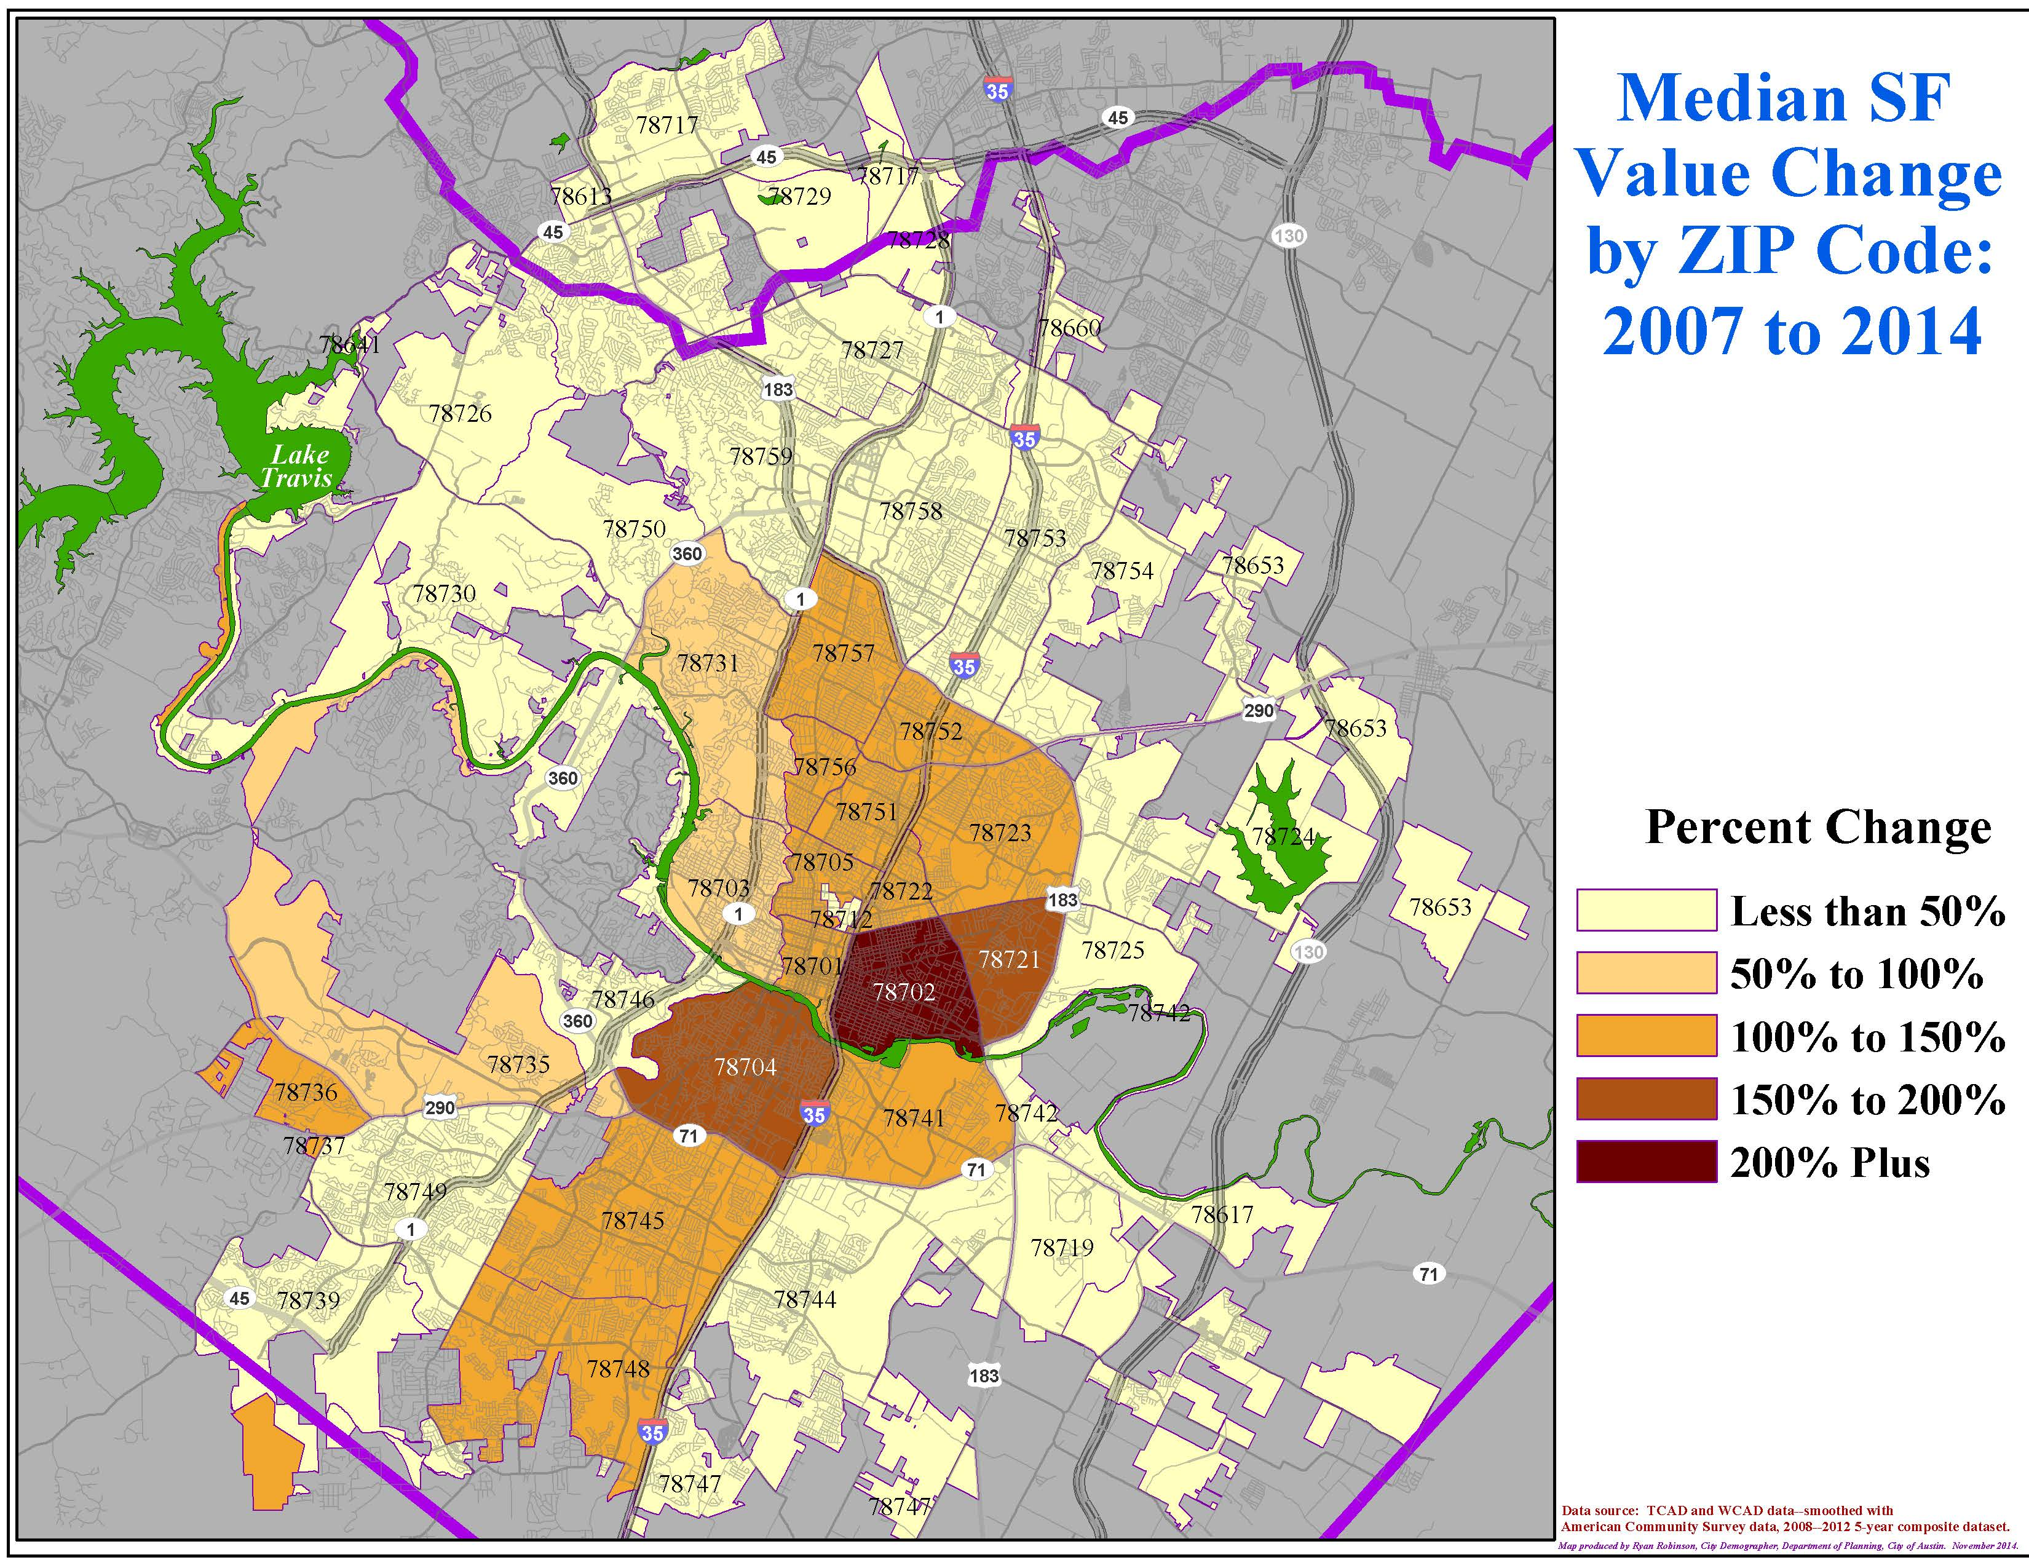

Slide 22
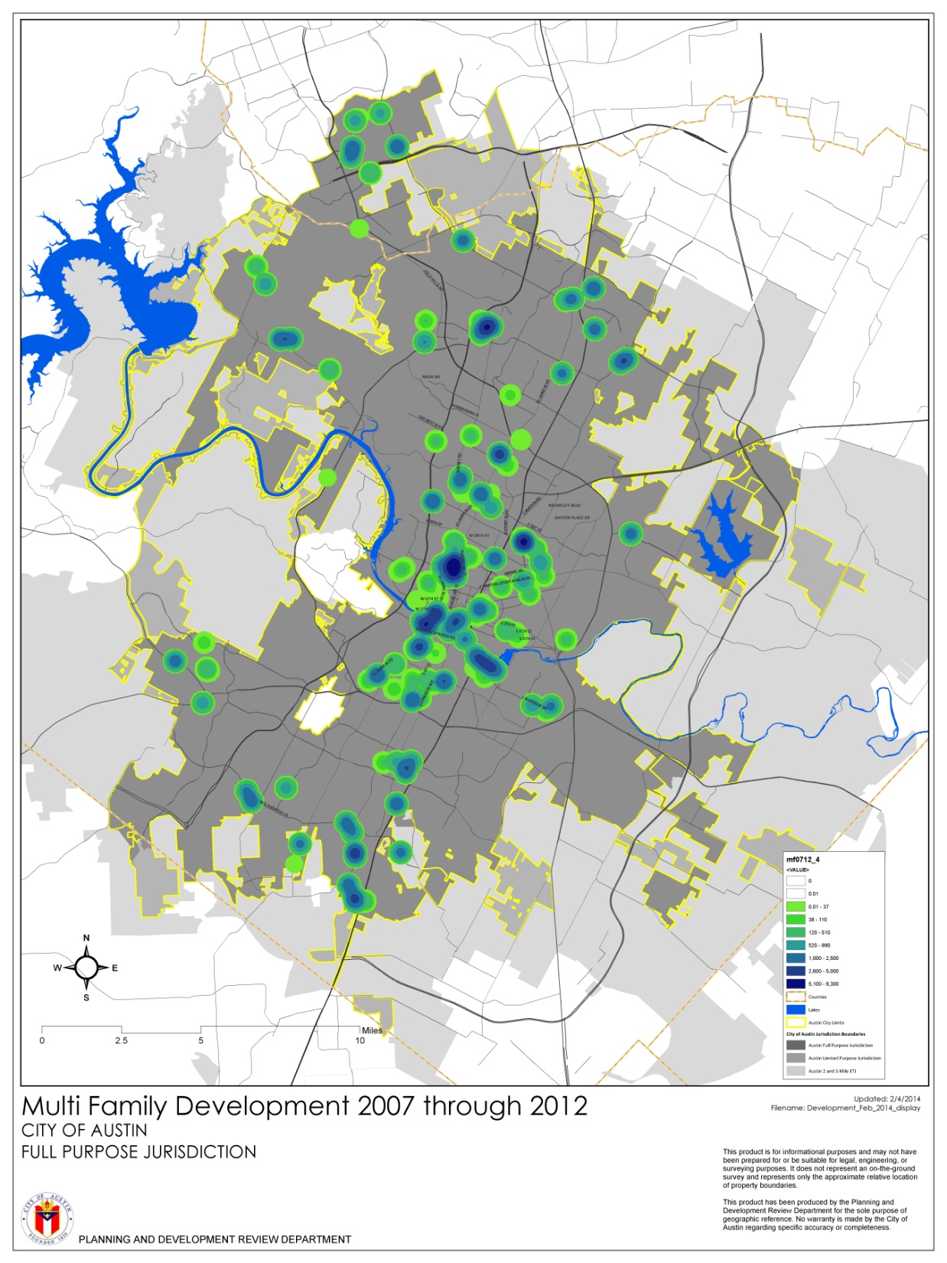
Apartment and Condo
Projects Under Construction,
November 2014

Slide 23
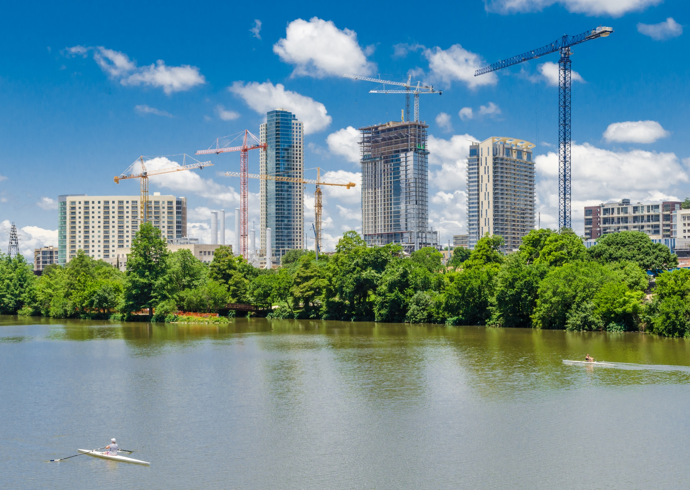

Slide 25
A Demographic Snapshot of Austin
A continuation of robust job and population growth.
Diversification may be slowing.
A massive collapse in Austin’s overall affordability is well underway.
Austin is still a mecca for millennials but is also now an emerging destination for retirees.
Notes:
25
25

Slide 26
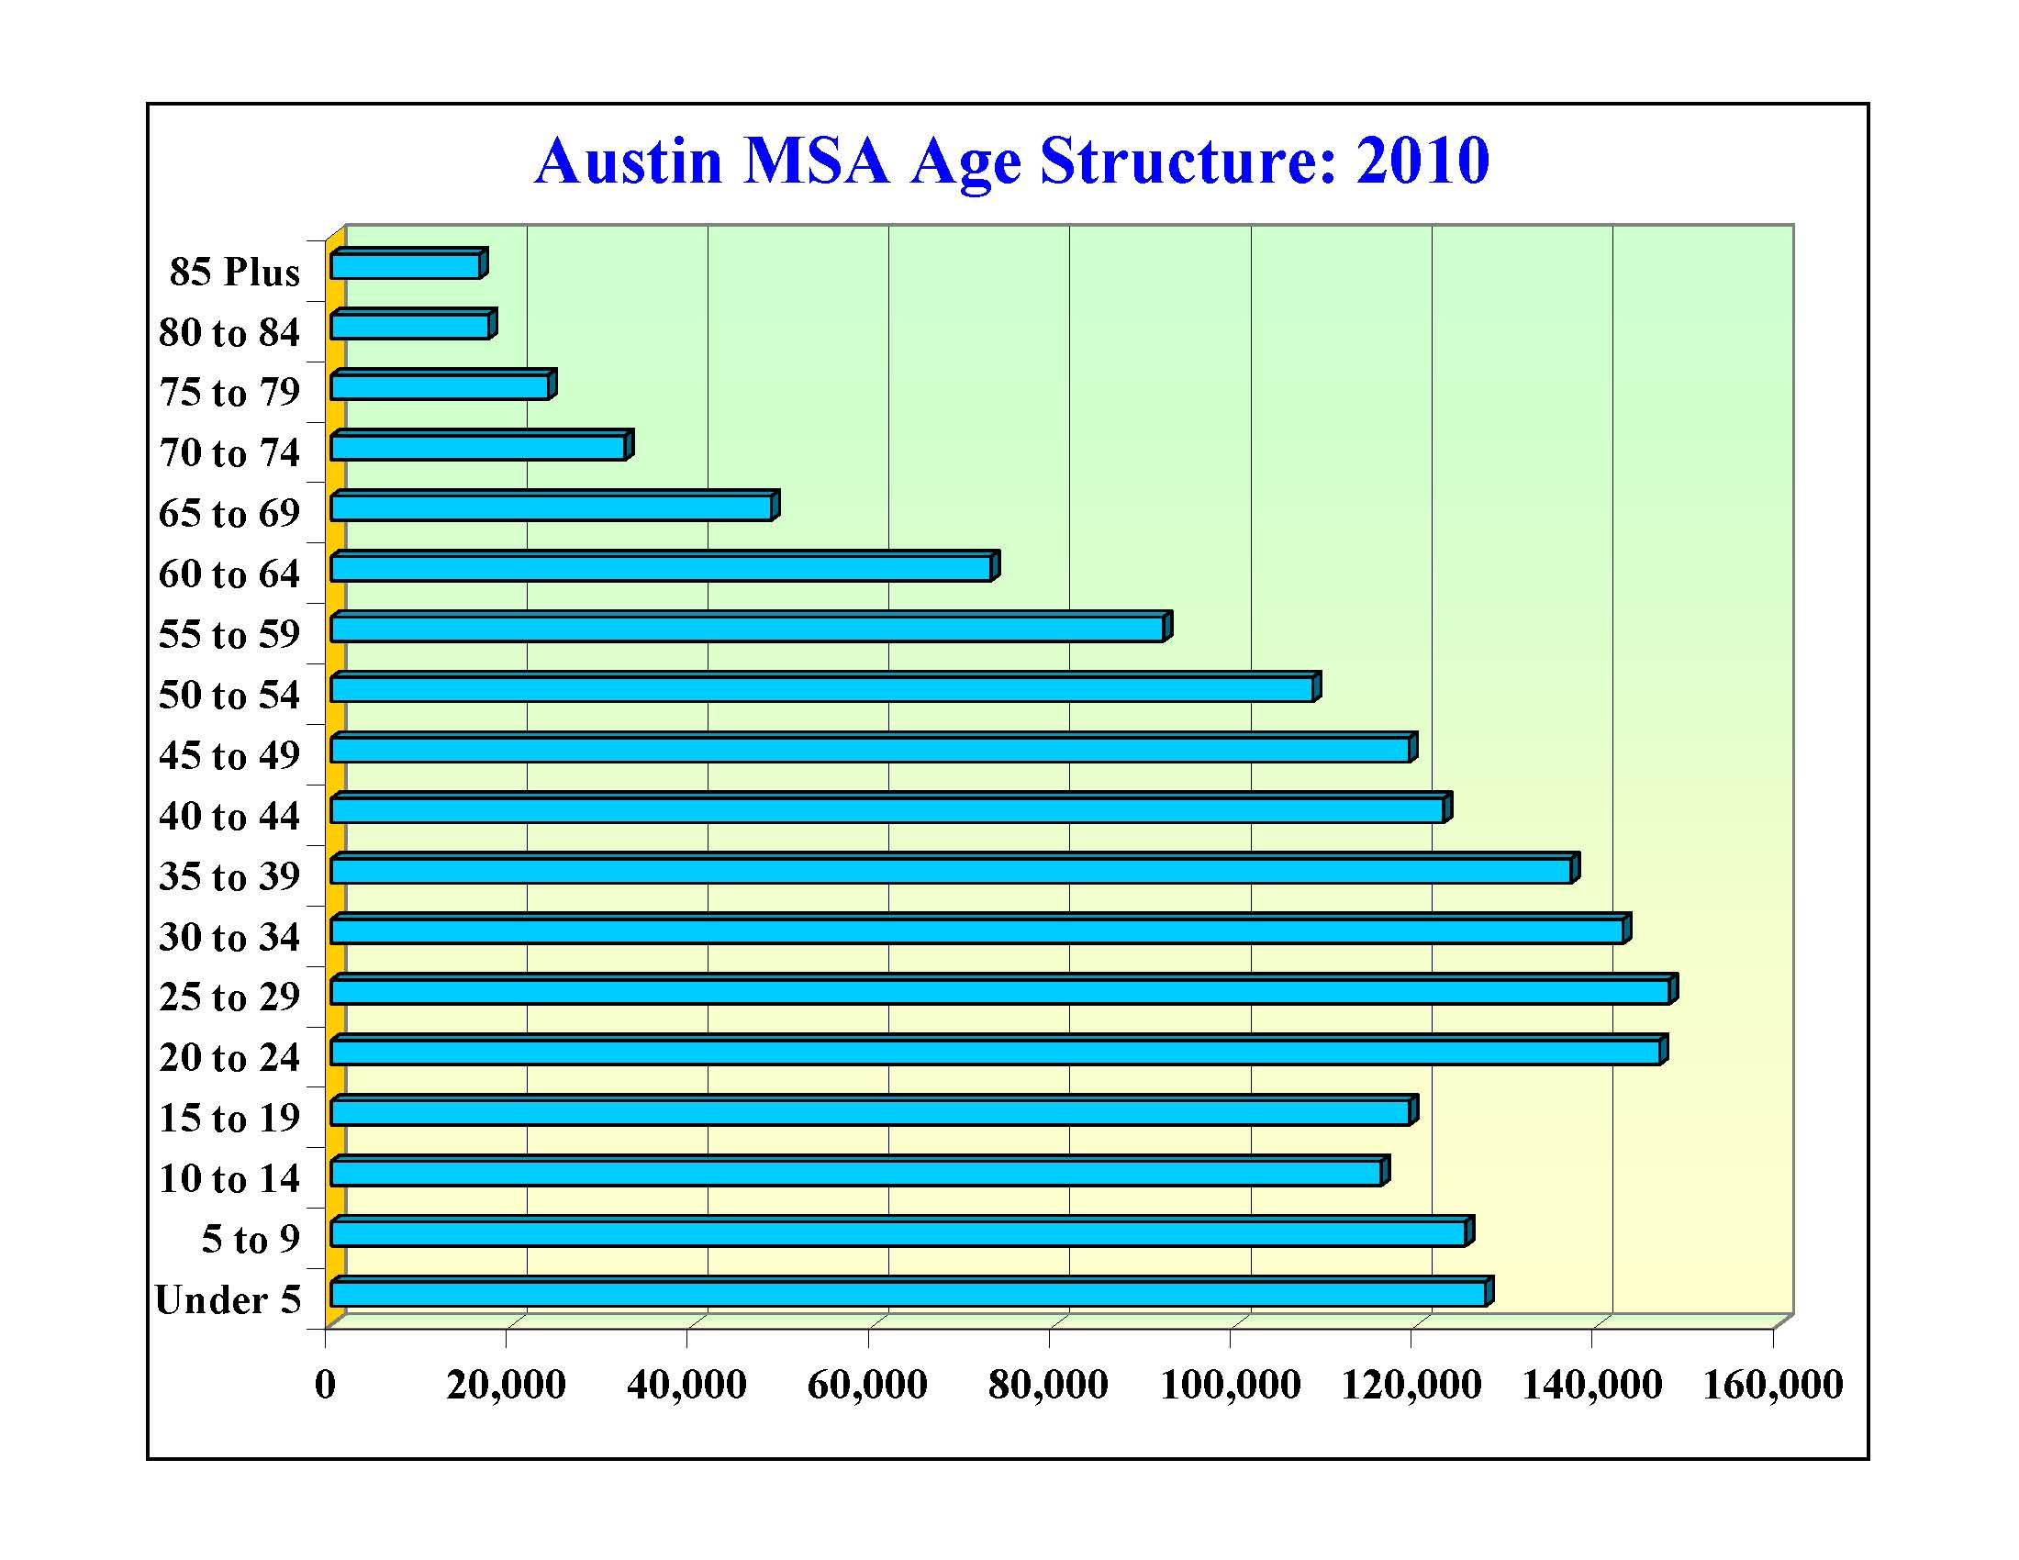

Slide 27
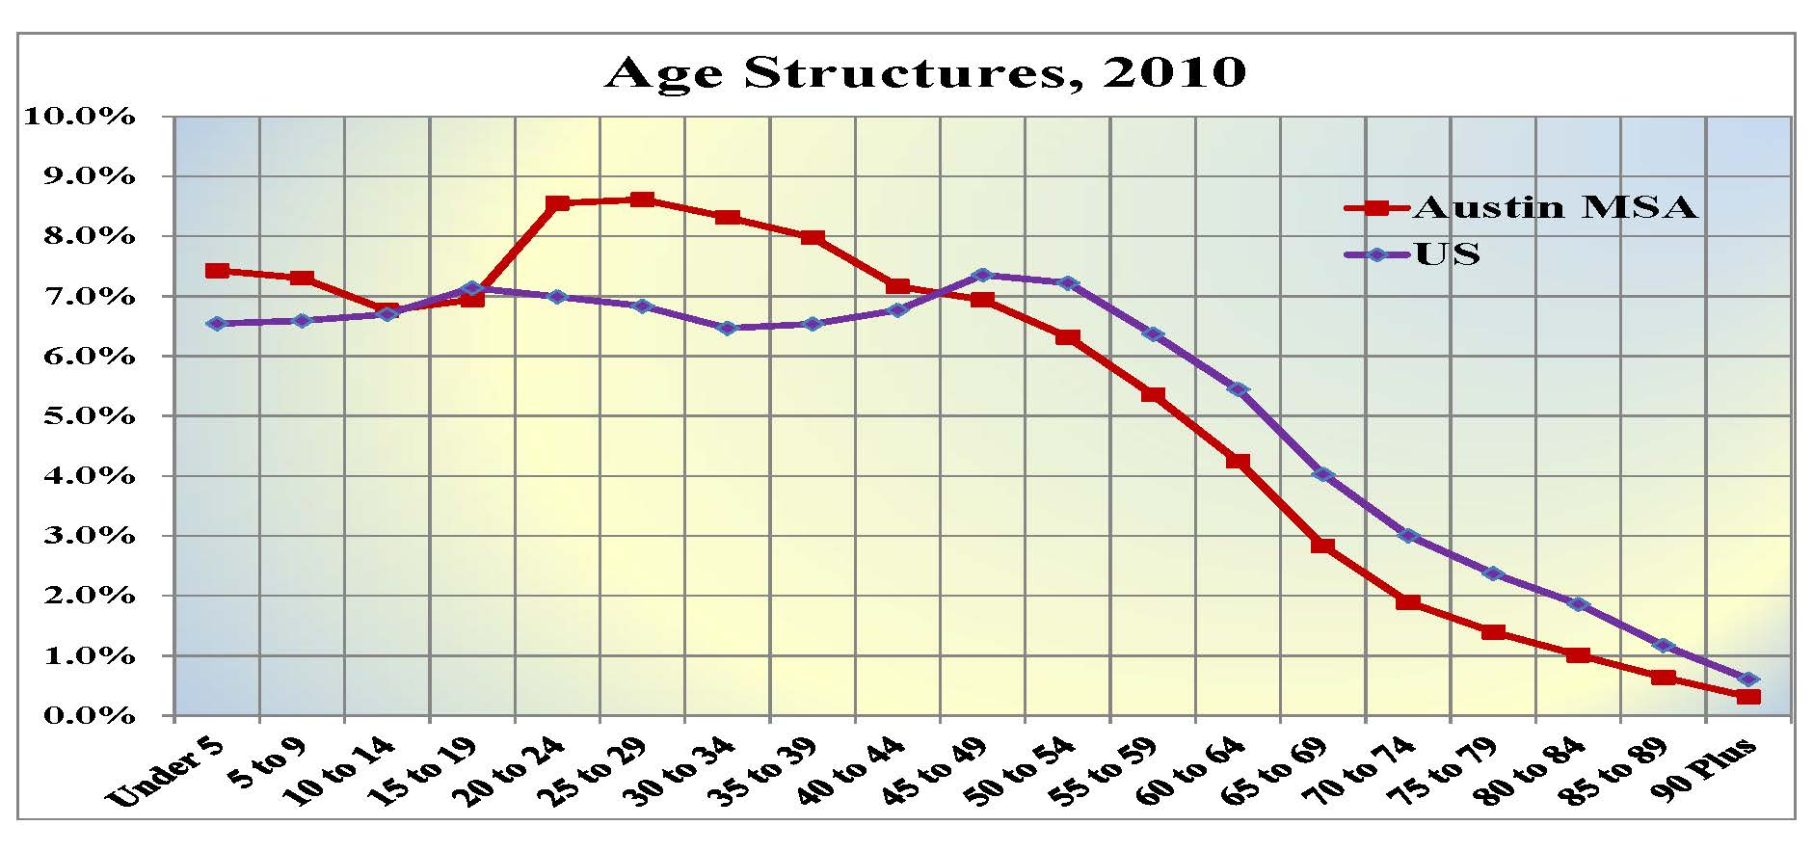
DATA SOURCE: 2007 American Community Survey Data, Table B19113, US Census Bureau.

Slide 28
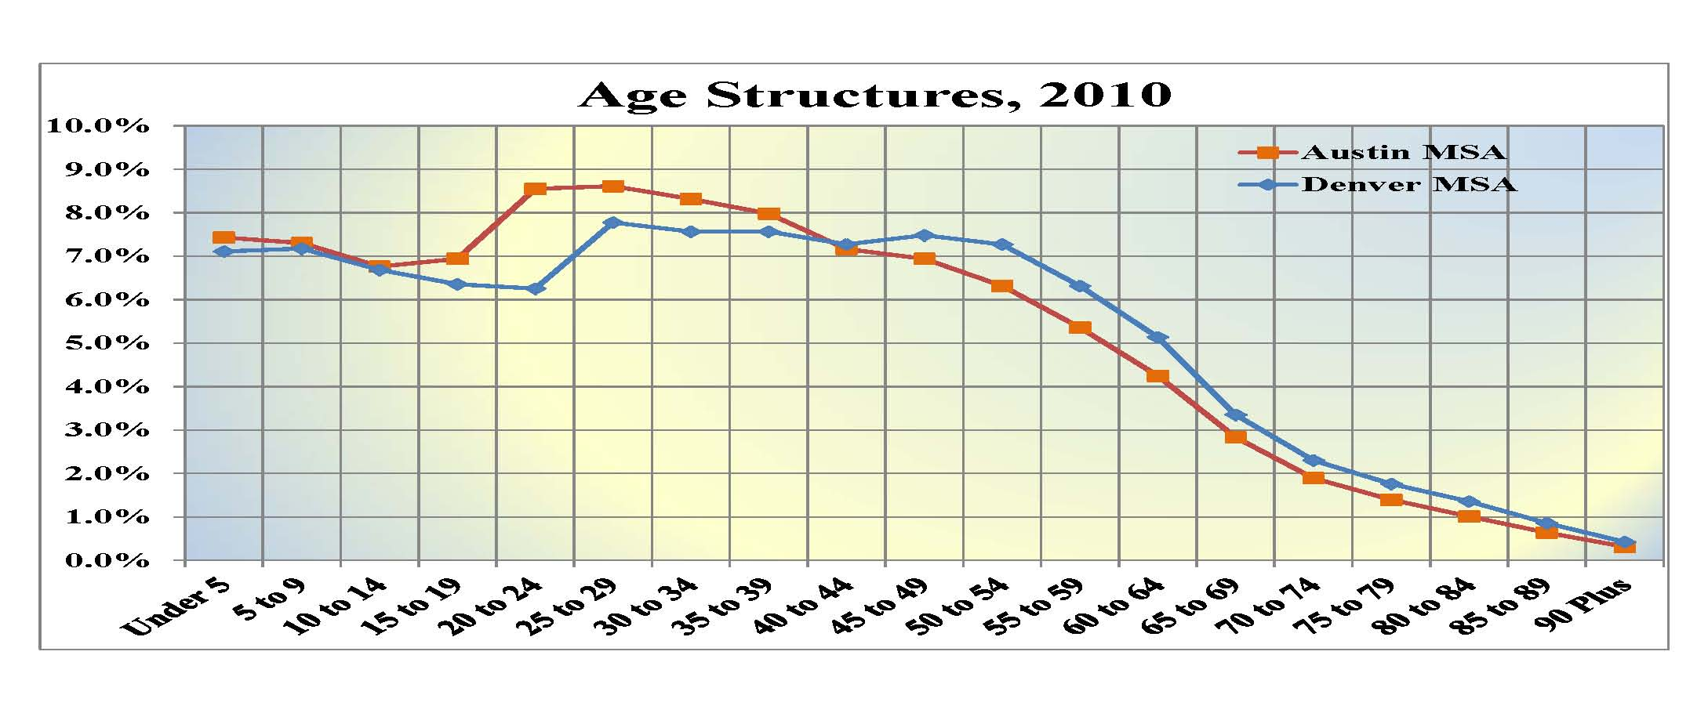
DATA SOURCE: 2007 American Community Survey Data, Table B19113, US Census Bureau.

Slide 29
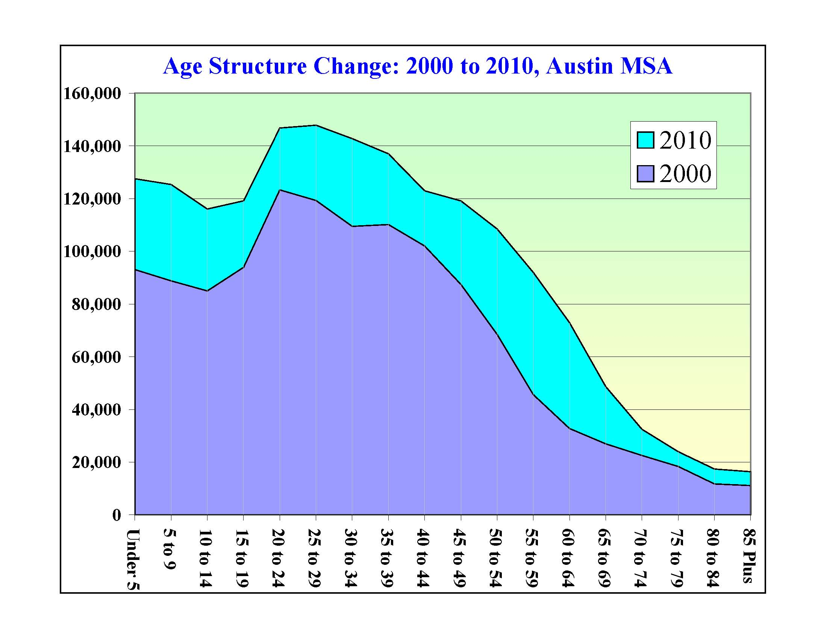

Slide 30
Metro Areas with Fastest Growing Senior and Pre-Senior Population, 2000 to 2010
Seniors (age 65 Plus)
Pre-Seniors (age 55 to 64)
Portland
Boise
Madison
Salt Lake City
Las Vegas
Raleigh
Colorado Springs
Riverside
Albuquerque
Charlotte
DFW
Atlanta
Austin
Houston

Slide 31
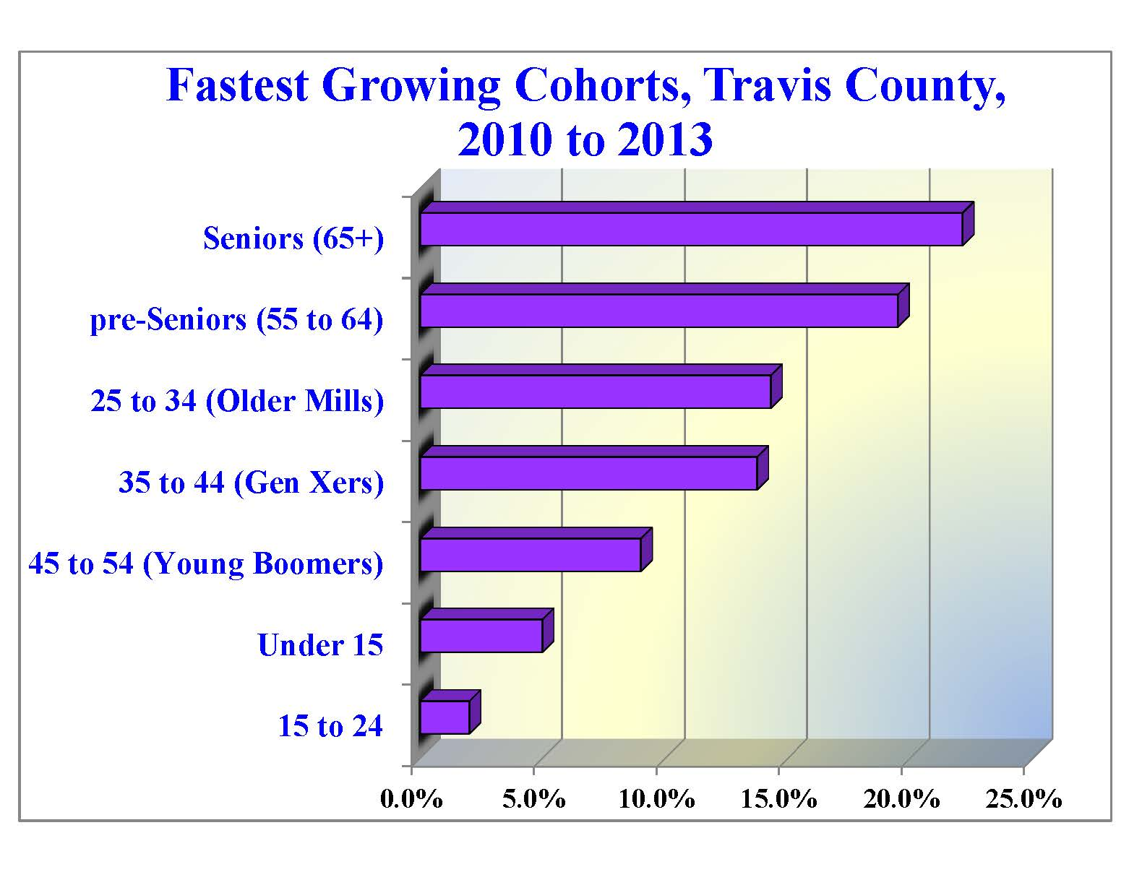

Slide 32
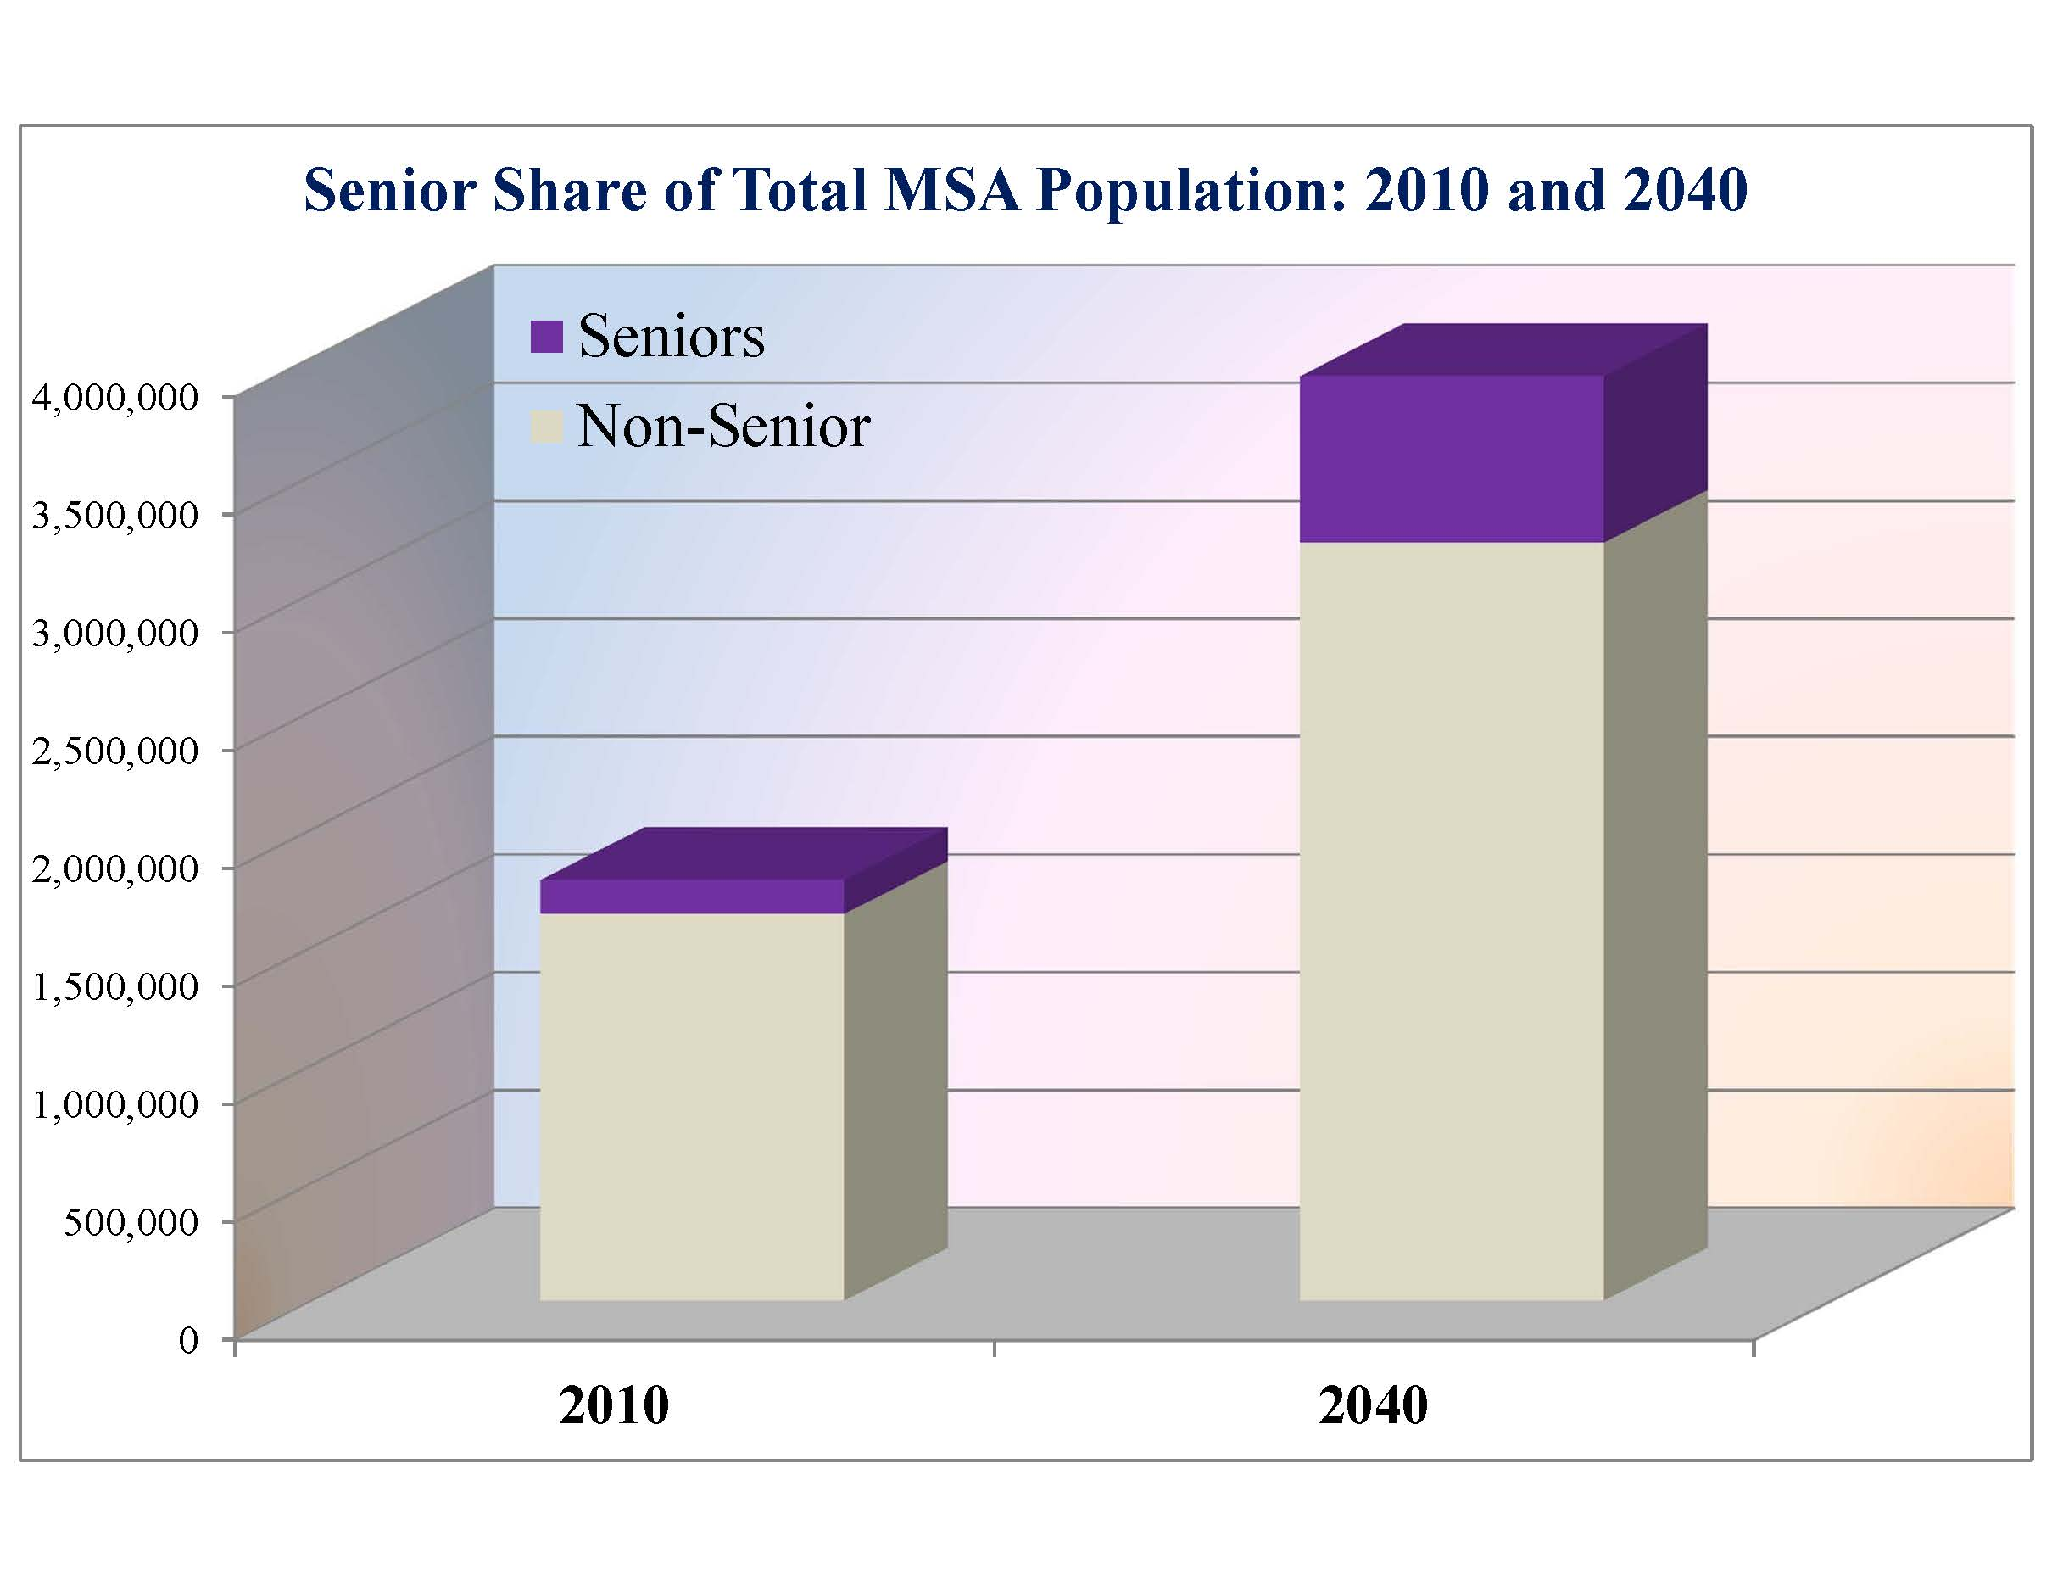
18% of
3.9 million,
or 700K
8.0% of 1.8 million,
or 140K

Slide 33
A Demographic Snapshot of Austin
A continuation of robust job and population growth.
Diversification may be slowing.
A massive collapse in Austin’s overall affordability is well underway.
Austin is still a mecca for millennials but is also now an emerging destination for retirees.
Stubborn socioeconomic separations may be getting worse.
Notes:
33
33

Slide 34
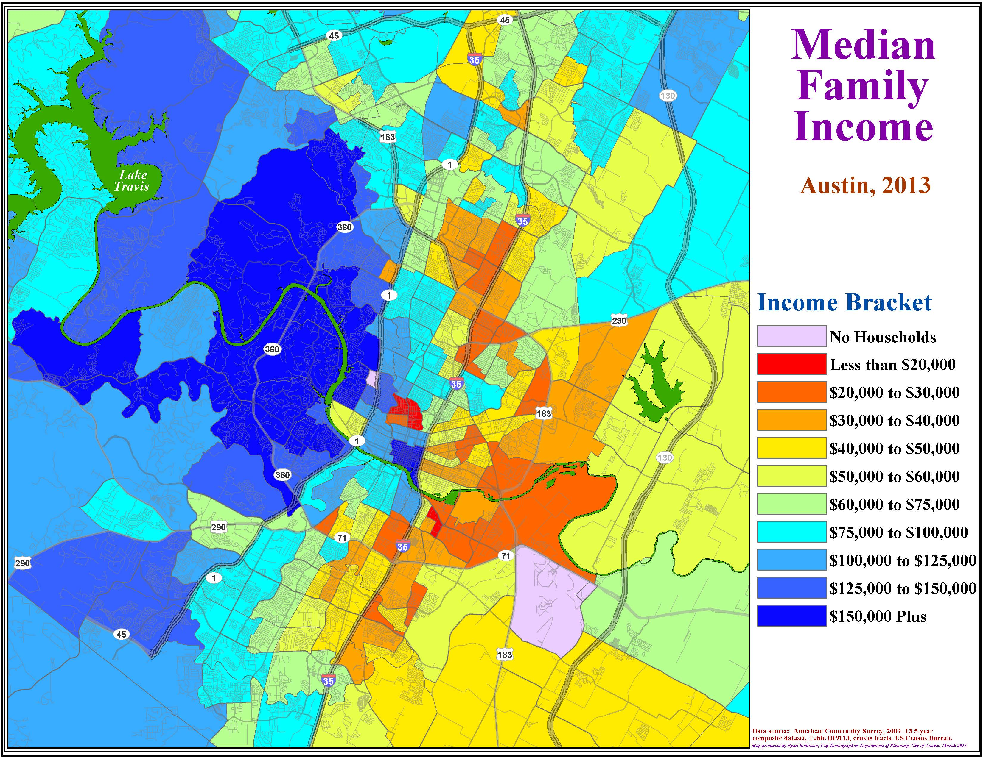

Slide 36
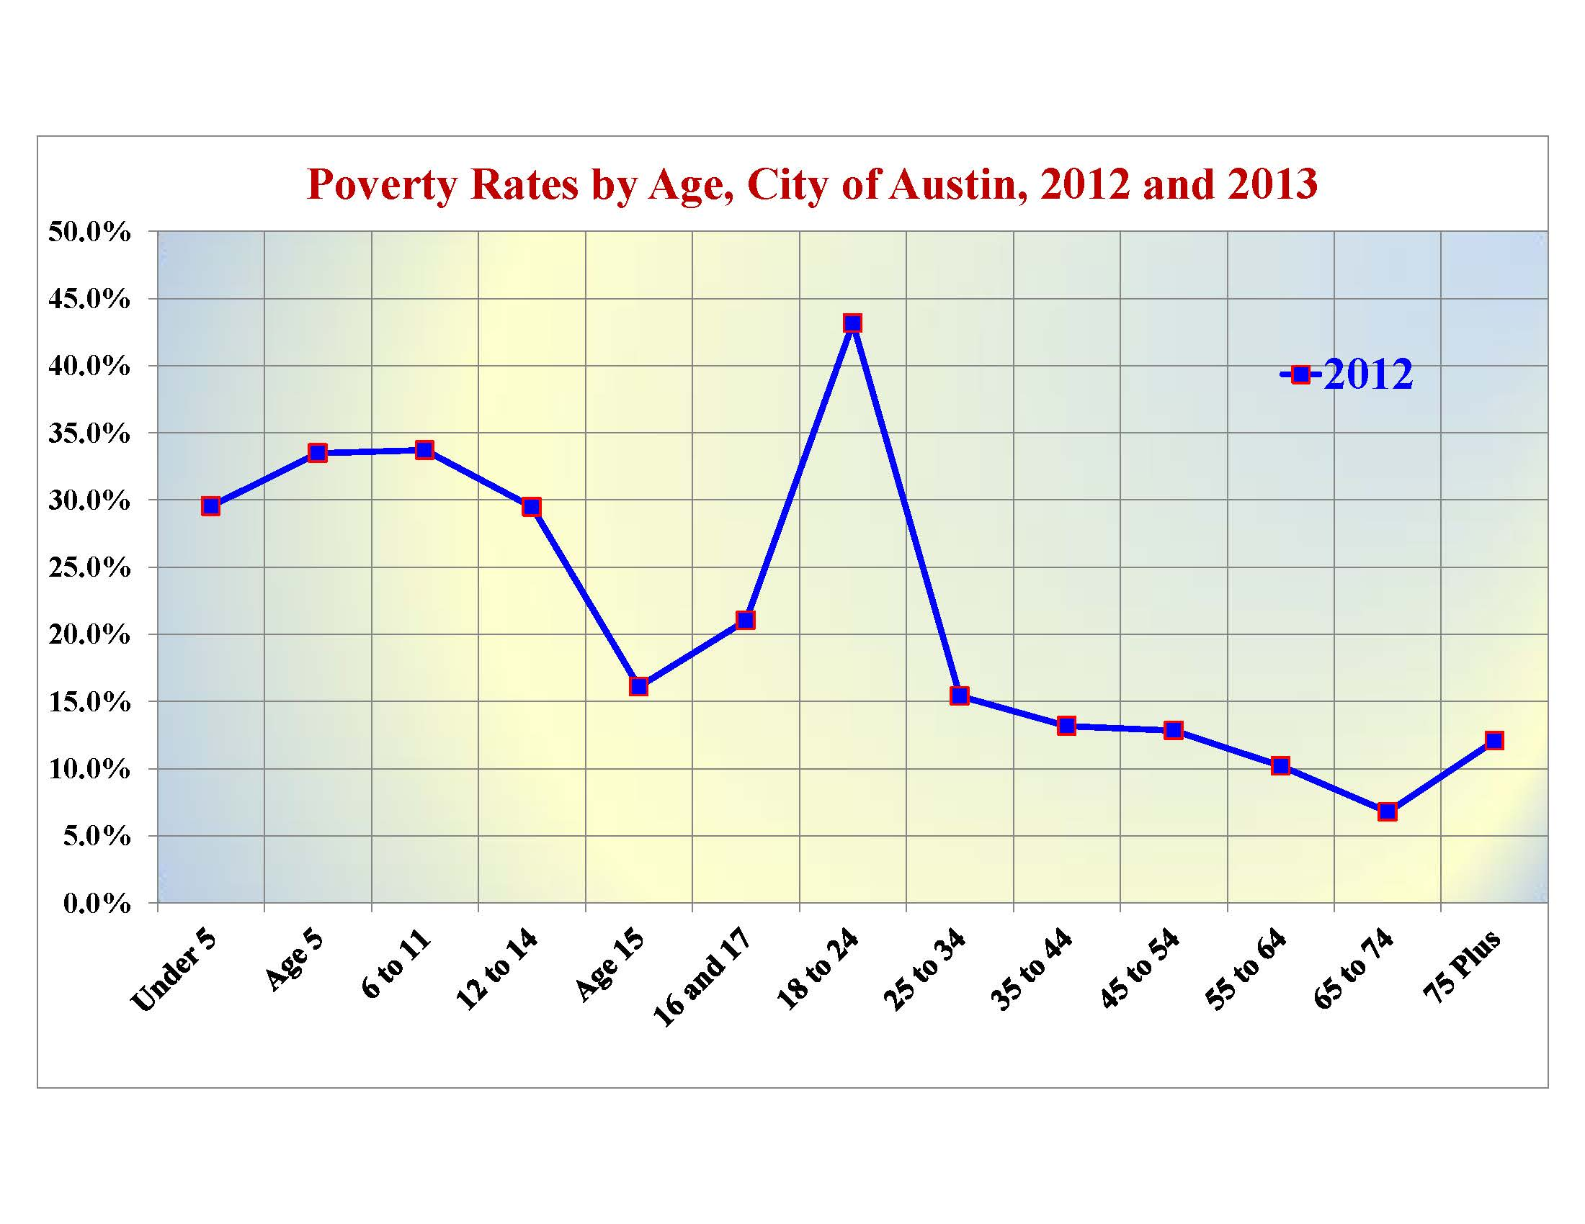
Overall Poverty Rate, 2012 = 20.3%

Slide 37
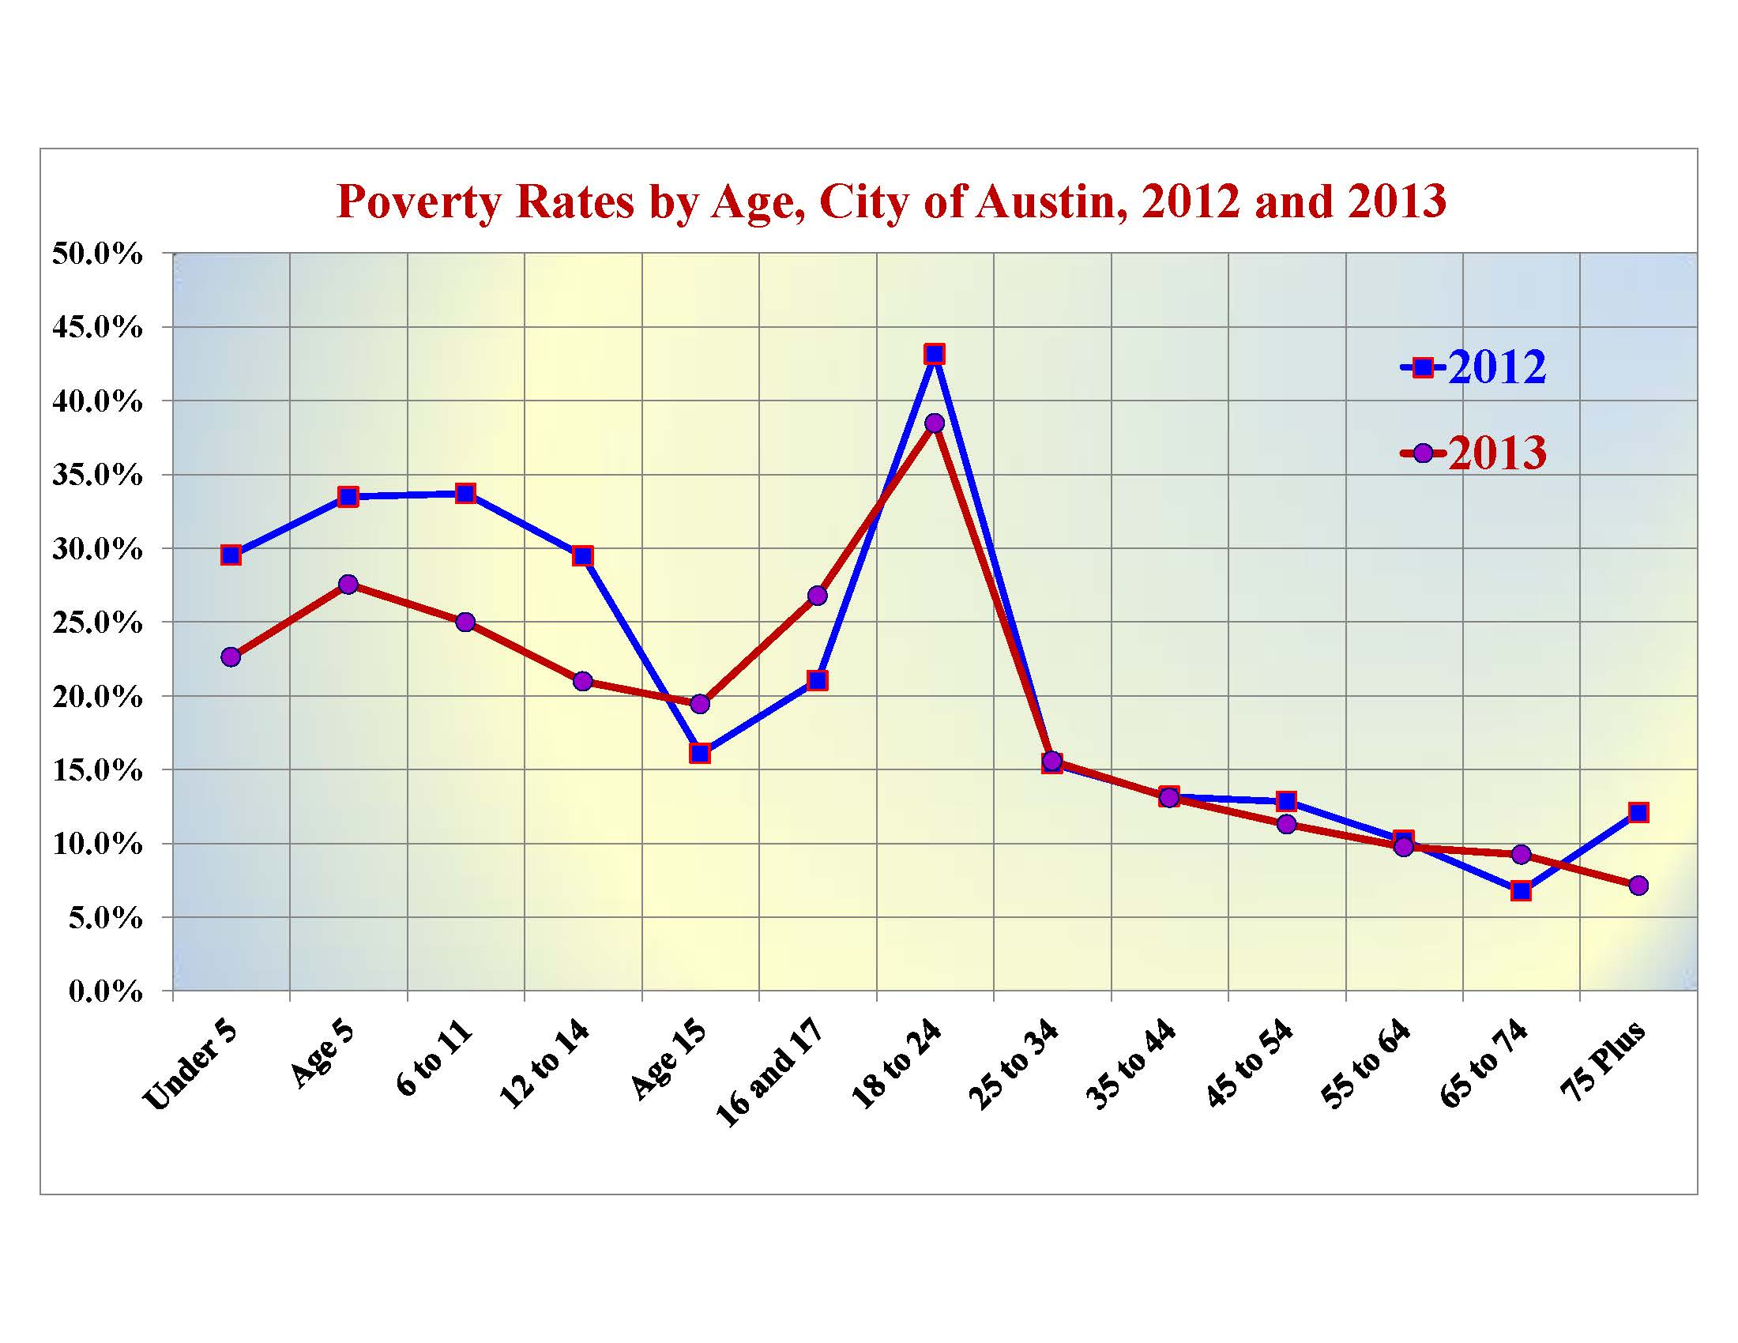
Overall Poverty Rate, 2012 = 20.3%
Overall Poverty Rate, 2013 = 17.8%

Slide 38
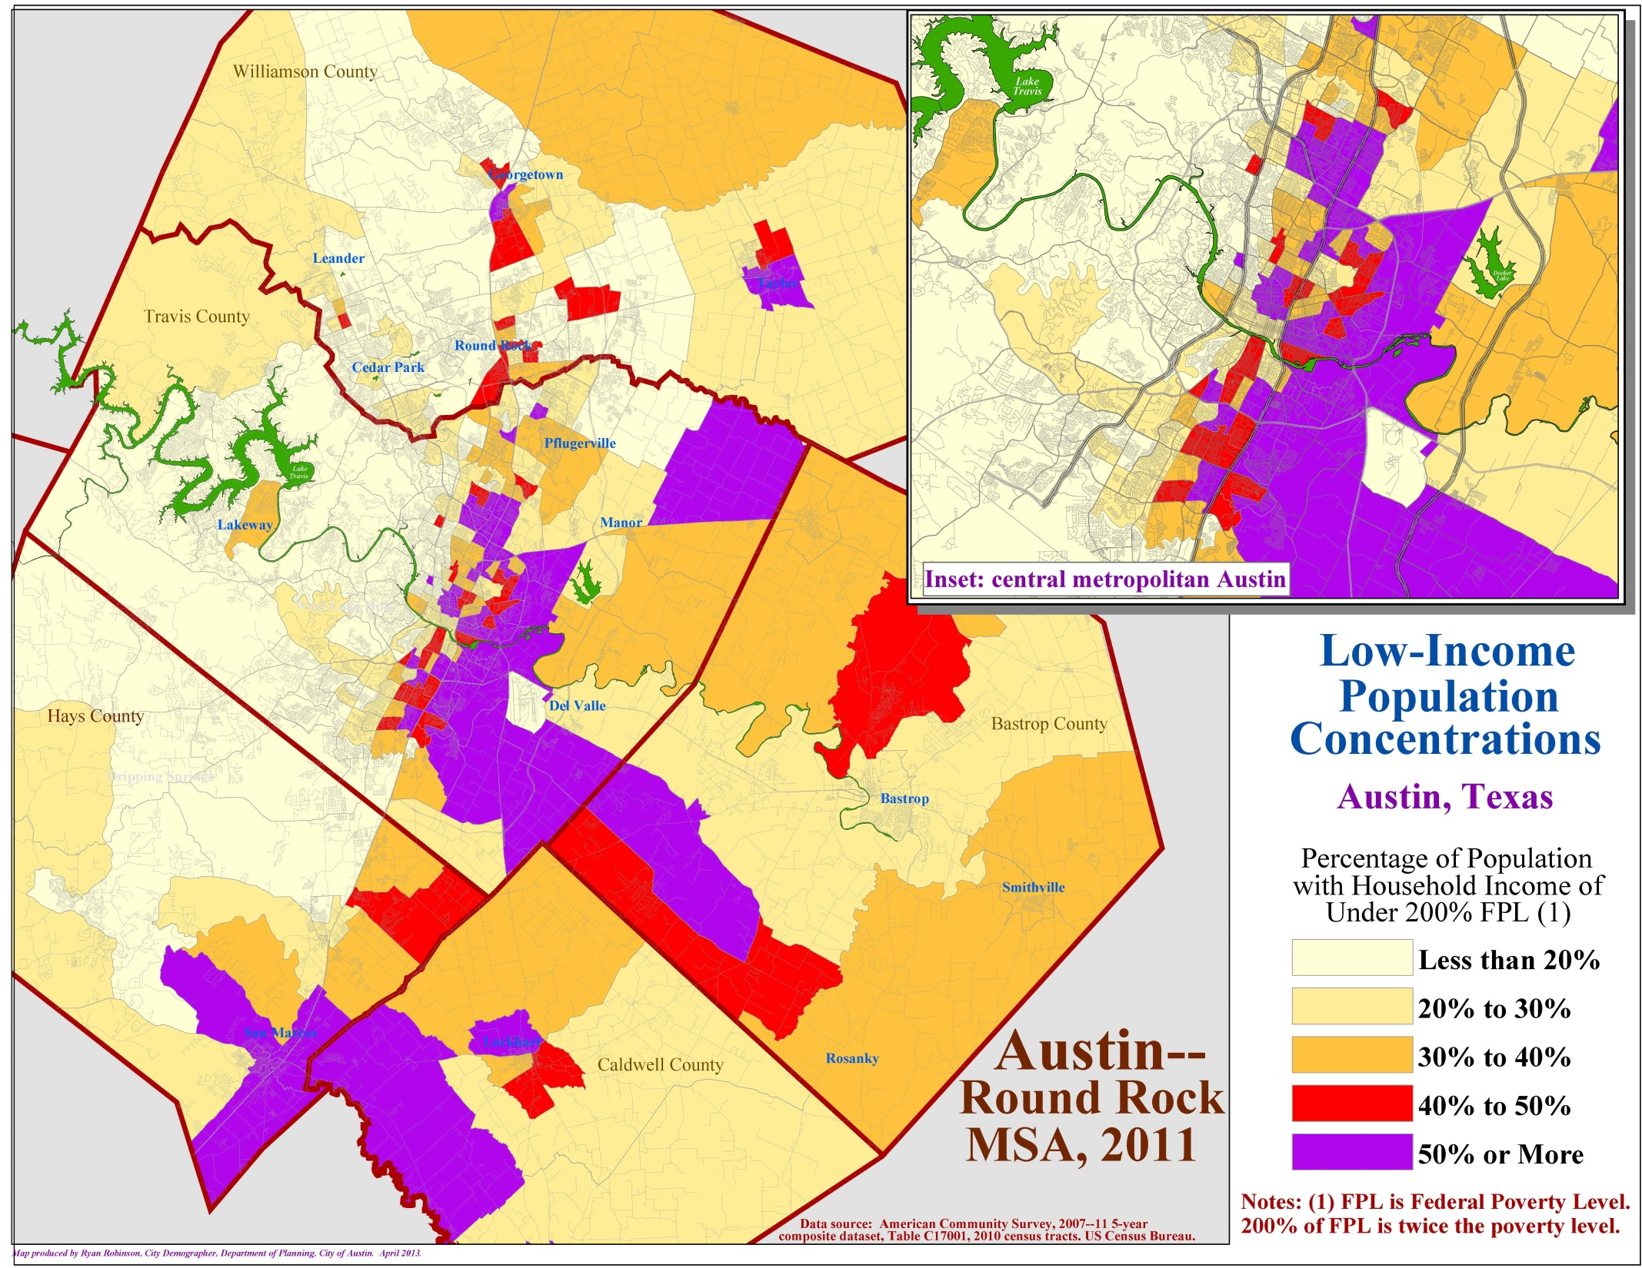

Slide 39
