Slide 1
Austin’s Evolving Economy
THE BEST WAY TO PREDICT THE FUTURE ….
IS TO CREATE IT!

Slide 2
Program
U.S., Texas, & Austin Economies
Austin’s Economic Drivers
Growth Challenges to Overcome
Austin Tomorrow
Impact on Mobility
Innovative PPP

Slide 3
U.S. At-A-Glance
 | U.S. | Growth
Population Net Gain | 2,213,000 | 0.7%
Employment Net Gain | 2,323,000 | 1.7%
Retail Sales Net Gain | $170.2 Billion | 3.8%
Venture Capital | $41.7 Billion | 47.4%
Net Business Formation, 2012 | 78,000 | 4.2%
Median Household Income, 2013 | $52,000 | 0.3%
Housing Starts | 1.0 Million | -7.0%
Source: US Census, Bureau of Labor Statistics, PriceWaterhouseCoopers, Texas A&M Real Estate Center

Slide 4
Texas At-A-Glance
 | Texas | Growth
Population Net Gain | 397,000 | 1.5%
Employment Net Gain | 344,000 | 3.1%
Retail Sales Net Gain | $29.1 Billion | 6.7%
Venture Capital | $1.3 Billion | 12.0%
Net Business Formation, 2012 | 12,400 | 3.8%
Median Household Income, 2013 | $51,700 | 0.4%
Housing Starts | 97,000 | 0.6%
Source: US Census, Bureau of Labor Statistics, PriceWaterhouseCoopers, Texas A&M Real Estate Center

Slide 5
Austin At-A-Glance
 | Austin | Growth
Population Net Gain | 66,000 | 3.5%
Employment Net Gain | 39,100 | 4.5%
Retail Sales Net Gain | $2.1 Billion | 6.7%
Venture Capital | $557 Million | 22.6%
Net Business Formation, 2012 | 1,800 | 4.3%
Median Household Income, 2013 | $61,800 | 2.4%
Housing Starts | 11,200 | 17.9%
Source: US Census, Bureau of Labor Statistics, PriceWaterhouseCoopers, Texas A&M Real Estate Center

Slide 6
New Jobs Growth by Sector
Net New Jobs:
U.S. 2.3 Million
Texas 344,000
Source: Bureau of Labor Statistics

Slide 7
Employment Growth by Sector
1990 – 2013 Employment Growth by Sector
Sectors | Austin | Texas | U.S.
Construction | 234% | 67.5% | 11.3%
Manufacturing | 11% | -9.9% | -32.8%
Wholesale Trade | 253% | 50.8% | 10.8%
Retail Trade | 110% | 34.6% | 12.3%
Information | 124% | 14.3% | -1.9%
Finance and Insurance | 91% | 53.7% | 10.8%
Real Estate | 132% | 42.0% | 13.7%
Business Services | 257% | 126.8% | 64.8%
Educational Services | 182% | 70.1% | 42.8%
Health Care | 184% | 114.2% | 76.3%
Arts and Entertainment | 78% | 22.1% | 39.9%
Travel and Food Services | 191% | 105.9% | 54.2%
Public Administration | 31% | 36.2% | 13.5%
Source: Bureau of Labor Statistics

Slide 8
New Jobs Momentum
S&L Recession
Dot.com Recession
Great Recession
127%
61%
25%
U.S. Recessions
Source: Bureau of Labor Statistics

Slide 9
Program
Austin’s Economic Drivers

Slide 10
Austin’s Economic Drivers
Austin 30 Years Ago
Population Growth
High Tech: Emerging
Austin
Today
Population Growth
Technology & Entrepreneurship
Education & Healthcare
The Festival Economy
Government
Education

Slide 11
Austin’s Rapid Population Growth
1,974,000
758,510
Source: Texas A&M Real Estate Center, AngelouEconomics

Slide 12
Declining Dependence on Government
124
82
Gov. as a % of Total Employment | 27% | 24% | 19% | 20% | 21%
Source: Bureau of Labor Statistics

Slide 13
Austin’s Technology & Entrepreneurship
High Tech in 1990
High Tech Today
Growth
High Tech Manufacturing
Employment
Wages
27,600
$37,500
28,000
$119,700
2%
219%
High Tech Supply Chain
Employment
Wages
4,300
$46,200
21,900
$91,300
406%
98%
High Tech Info and IT
Employment
Wages
5,800
$33,800
16,300
$66,400
179%
97%
Professional Business Services
Employment
Wages
15,500
$33,300
55,500
$85,500
257%
156%
Total High Tech
Employment
Wages
53,300
$36,600
121,700
$91,100
128%
151%
Source: Bureau of Labor Statistics

Slide 14
Austin’s Technology & Entrepreneurship
Tech. Companies of the ‘80s & ‘90s
Tech. Companies Today
Austin startups have received over $12 billion in venture capital funding from 1995 to 2014
Source: Price Waterhouse and Cooper, AngelouEconomics

Slide 15
Austin Based Public Companies
 | 2013 Revenue | Growth
Whole Foods Market Inc. | $12,920 | 10%
Freescale Semiconductor Inc. | $4,190 | 6%
National Instruments Corp. | $1,170 | 3%
Hanger Inc. | $1,050 | 8%
EZCORP Inc. | $1,010 | 2%
All Other (20) | $6,416 | 28%
Total | $26,756 | 12%
Source: Austin Business Journal, Yahoo Finance

Slide 16
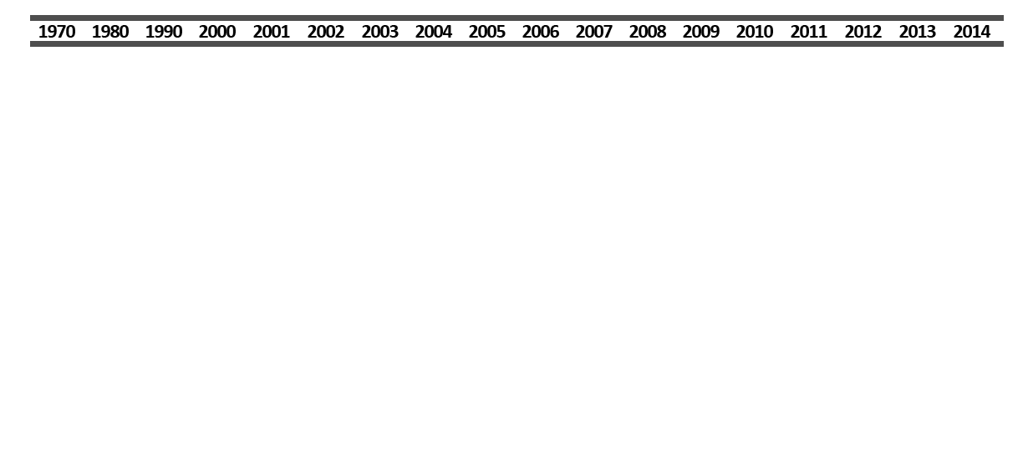
The Austin Festival Economy
Began in: 1987
2014 Attendance: 376,600
2014 Economic Impact: $315.8M
Began in: 2002
2013 Attendance: 75,000 a day
2013 Economic Impact: $182M
Began in: 2006
2012 Attendance: 55,000
2012 Economic Impact: $27M
Began in: 2012
2012 Attendance: 1.1 million
2014 Economic Impact: $847M

Slide 17
Program
Growth Challenges to Overcome

Slide 18
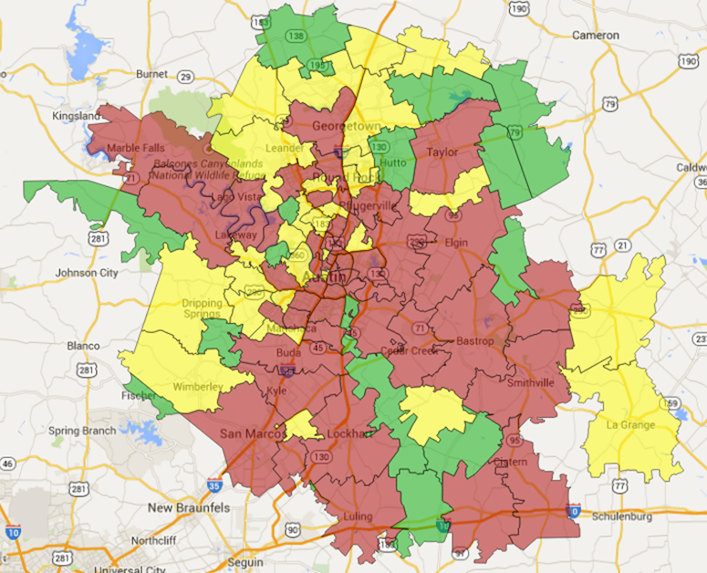
Rent Affordability Challenges
2013
Households Paying Rent > 35% of Income
 | 2013 | 2000
Raleigh MSA | 38.1% | 29.9%
Charlotte MSA | 38.1% | 25.5%
Boston MSA | 39.7% | 28.3%
Seattle MSA | 40.2% | 29.8%
San Jose MSA | 40.6% | 31.0%
Denver MSA | 41.0% | 30.5%
Austin MSA | 41.3% | 32.2%
Atlanta MSA | 42.6% | 28.5%
New York MSA | 45.4% | 32.5%
0% to 25%
25% to 35%
35% or more
Source: US Census

Slide 19
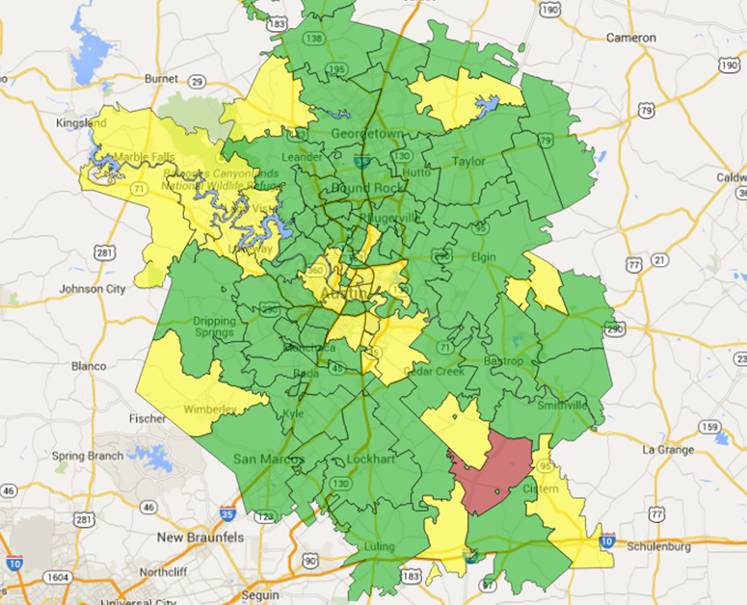
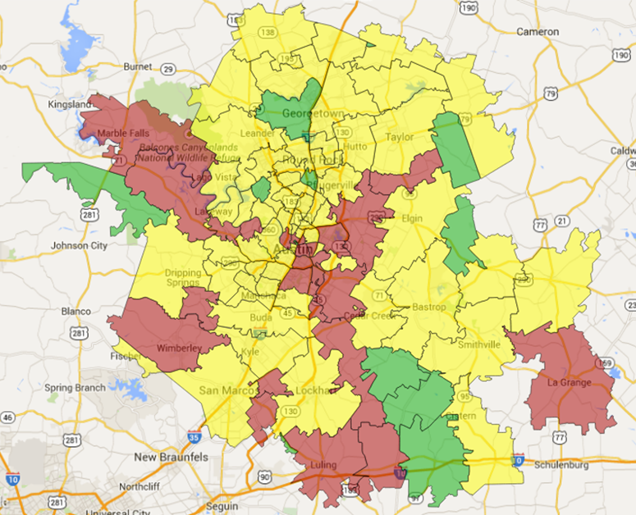
Mortgage Affordability Challenges
2013
2000
Mortgage Expenses > 35% of Income
 | 2013 | 2000
Raleigh MSA | 18.0% | 14.4%
Charlotte MSA | 20.1% | 14.7%
Austin MSA | 20.9% | 13.7%
Denver MSA | 21.9% | 16.6%
Atlanta MSA | 23.0% | 15.4%
Boston MSA | 24.9% | 16.2%
Seattle MSA | 26.0% | 19.0%
San Jose MSA | 28.6% | 22.2%
New York MSA | 35.5% | 22.3%
0 to 15%
Source: US Census
15% to 30%
30% or more

Slide 20
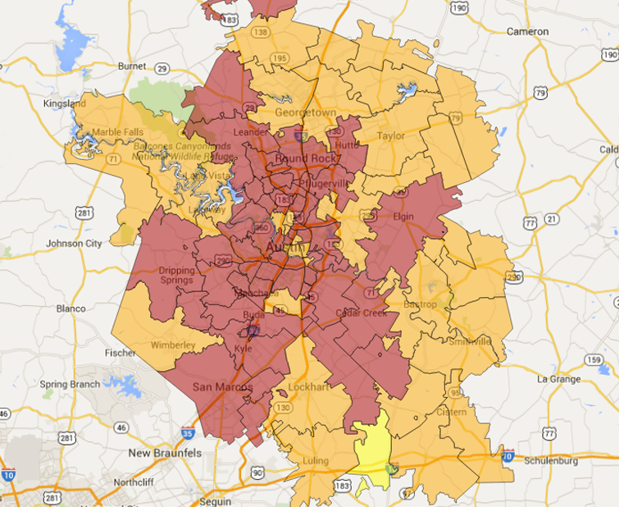
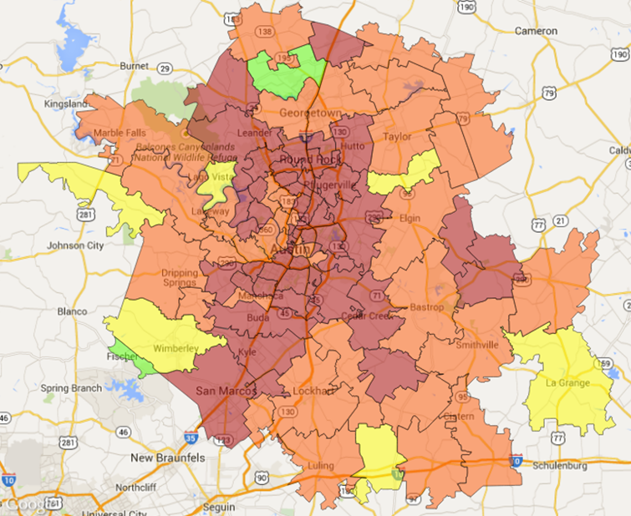
Healthcare – > 65
2013
Percent of Population over 65 years of age
 | 2013 | 2000
Boston MSA | 14.0% | 12.6%
New York MSA | 13.9% | 12.7%
Seattle MSA | 12.0% | 10.3%
San Jose | 12.0% | 11.1%
Charlotte MSA | 12.0% | 10.2%
Denver MSA | 11.2% | 8.8%
Atlanta MSA | 10.3% | 7.5%
Raleigh MSA | 10.2% | 8.7%
Austin MSA | 9.2% | 7.3%
2000
0 to 10%
10% to 20%
20% to 30%
30% and over
Source: US Census

Slide 21
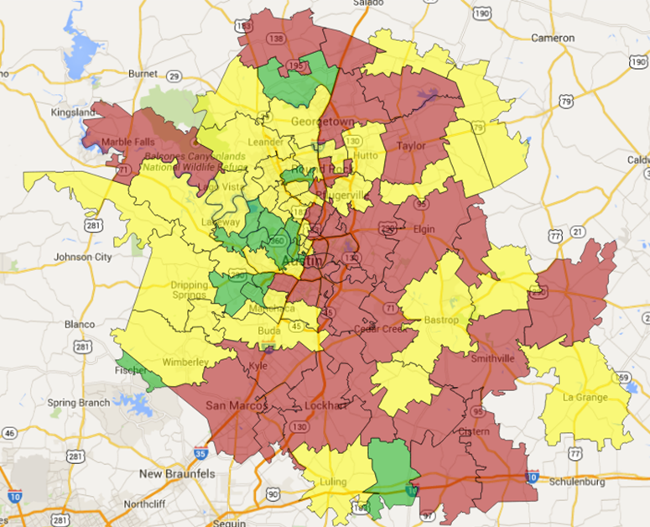
Healthcare - Uninsured
2013
Percent of Population with No Health Insurance 2013
Atlanta MSA | 18.7%
Austin MSA | 17.4%
Charlotte MSA | 15.9%
Denver MSA | 14.1%
Raleigh MSA | 13.5%
New York MSA | 12.5%
Seattle MSA | 12.4%
San Jose MSA | 11.1%
Boston MSA | 4.2%
0 to 10%
Source: US Census
10% to 20%
20% or more

Slide 22
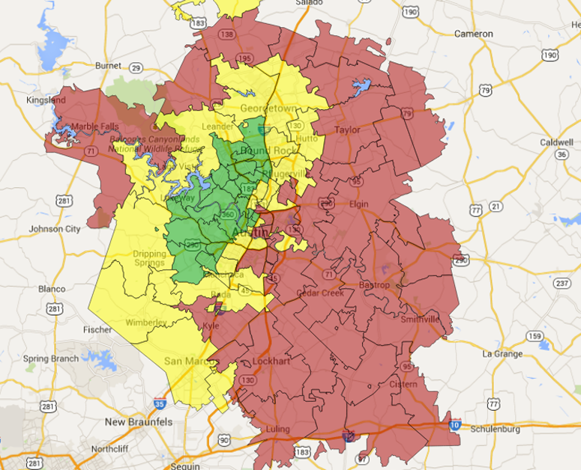
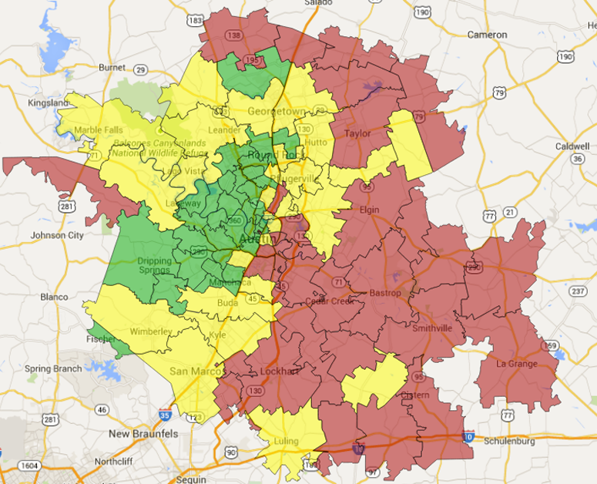
Education: Higher Education
2013
Percent of Population 25 Years or Older with a Bachelors Degree
 | 2013 | 2000
Raleigh MSA | 38.1% | 24.6%
Charlotte MSA | 38.1% | 19.0%
Boston MSA | 39.7% | 20.5%
Seattle MSA | 40.2% | 21.5%
San Jose MSA | 40.6% | 23.2%
Denver MSA | 41.0% | 23.4%
Austin MSA | 41.3% | 24.3%
Atlanta MSA | 42.6% | 21.6%
New York MSA | 45.4% | 17.9%
2000
0 to 15%
Source: US Census
15% to 30%
30% or more

Slide 23
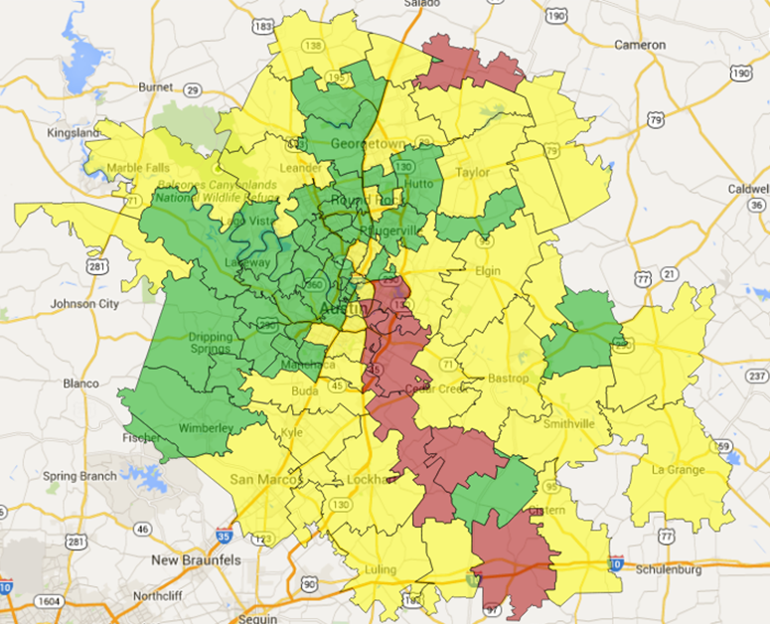
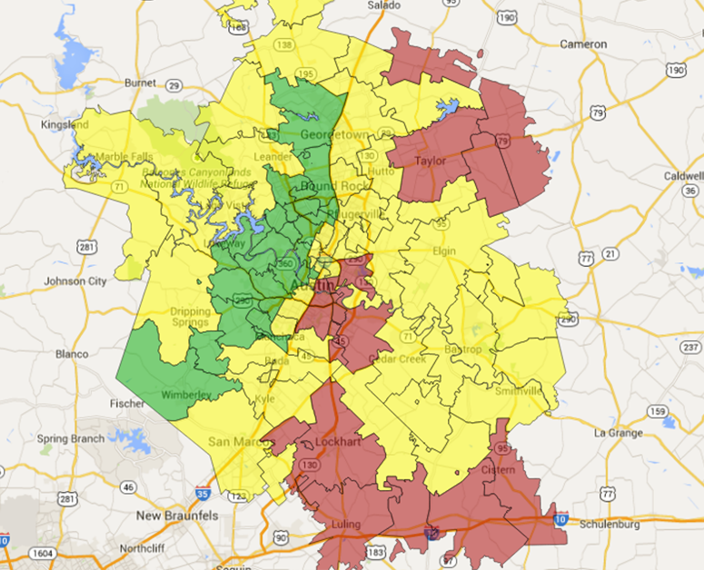
Education: No School Diploma
2000
2013
Percent of Population Without a High School Diploma
 | 2013 | 2000
Boston MSA | 4.4% | 8.9%
Seattle MSA | 5.1% | 7.4%
Raleigh MSA | 5.4% | 9.2%
Denver MSA | 5.8% | 8.3%
Austin MSA | 5.8% | 8.0%
San Jose MSA | 6.2% | 8.5%
Atlanta MSA | 6.9% | 10.6%
New York MSA | 7.1% | 12.2%
Charlotte MSA | 8.0% | 13.0%
0 to 5%
Source: US Census
5% to 15%
15% or more

Slide 24
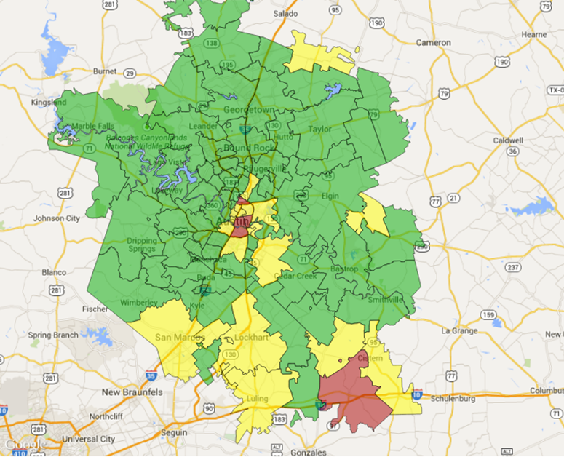
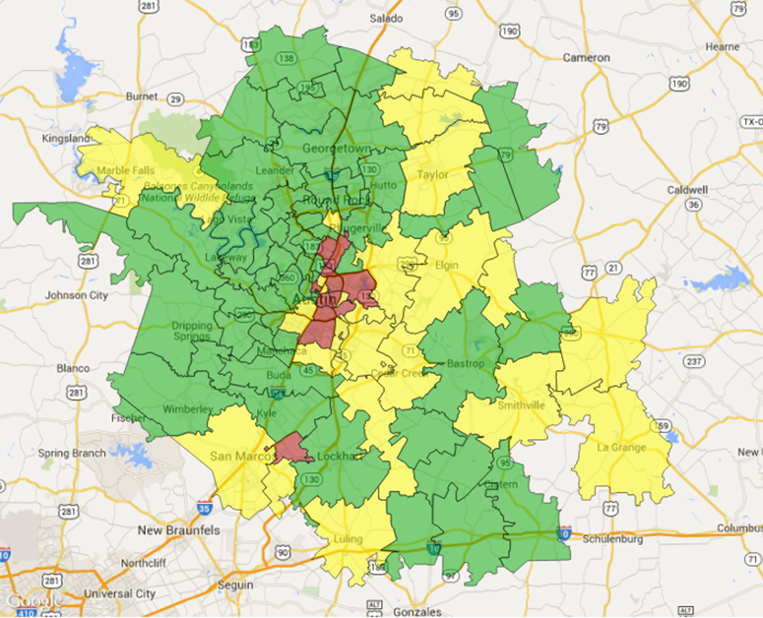
Poverty Levels
2013
2000
Percentage of Families Below Poverty
 | 2013 | 2000
San Jose MSA | 7.2% | 5.7%
Boston MSA | 7.2% | 6.0%
Seattle MSA | 8.4% | 5.8%
Denver MSA | 8.6% | 5.6%
Raleigh MSA | 8.7% | 6.7%
Austin MSA | 9.2% | 6.7%
Charlotte MSA | 11.1% | 6.8%
New York MSA | 11.3% | 10.2%
Atlanta MSA | 12.0% | 6.9%
0 to 10%
Source: US Census
10% to 20%
20% or more

Slide 25
Affordability Challenges
Austin MSA | Average Home Price | Average Wage
1990 | $88k | $22k
2013 | $287k | $52k
Growth | 227% | 137%
Median Home Prices (Nov. 2014)
San Jose | $735k
New York | $549k
Seattle | $469k
Boston | $441k
Denver | $285k
Raleigh | $191k
Atlanta | $163k
Source: US Census, Numbeo.com, BLS, Texas A&M Real Estate Center

Slide 26
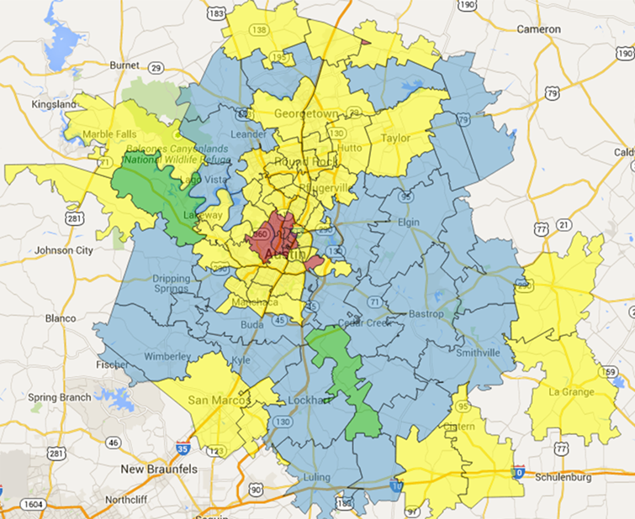
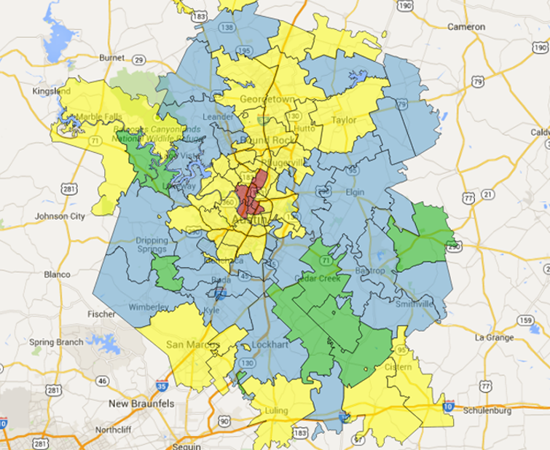
Challenges of Growth: Traffic
2013
Average Commute Time in Minutes
 | 2013 | 2000
Raleigh MSA | 25.6 | 24.9
Charlotte MSA | 26.0 | 26.1
Austin MSA | 26.4 | 25.5
San Jose MSA | 26.5 | 29.3
Denver MSA | 27.1 | 25.9
Seattle MSA | 28.6 | 27.7
Boston MSA | 30.0 | 27.8
Atlanta MSA | 30.0 | 31.2
New York MSA | 35.5 | 34.0
2000
0 to 20 Minutes
30 to 40 Minutes
20 to 30 Minutes
40 to 55 Minutes
Source: US Census

Slide 27
Program
Austin Tomorrow

Slide 28
Economic Driver: Austin Tomorrow
Austin Tomorrow
Shared Economy
Medical /Life Science
The Internet of Things
Entrepreneurially Driven

Slide 29
New Jobs by Sector
Growth
7.4%
8.4%
5.7%
3.0%
7.1%
4.1%
1.0%
3.5%
3.7%
2.5%
3.0%
4.9%
Source: Bureau of Labor Statistics

Slide 30
Austin Job Growth Forecast 2015 - 2016
Industries
Jobs Gained
Growth Rate
12.8%
12.2%
10.3%
5.7%
8.8%
2.0%
6.4%
5.6%
6.9%
3.7%
7.4%
10.6%
Total Jobs
69,400
7.7% Growth
Source: AngelouEconomics, Dallas Federal Reserve

Slide 31
Rapid Population Growth: If 100 People….
If 100 workers moved to Austin…
2013
1993
Average Pay in 2013
Average Pay in 1993
Pay Growth
Professional and Business Services
Leisure and Hospitality
Trade, Transportation, and Utilities
Education and Health Services
Construction
Financial Activities
Manufacturing
Information
Other Services
$ 64,500 | $27,500 | 135%
$ 19,700 | $10,400 | 90%
$ 47,900 | $22,100 | 117%
$ 44,100 | $23,000 | 92%
$ 50,600 | $25,800 | 96%
$ 73,400 | $28,500 | 157%
$ 89,900 | $36,300 | 147%
$ 77,900 | $37,600 | 107%
N/A | N/A
Source: Bureau of Labor Statistics

Slide 32
Austin Population Forecast
Source: AngelouEconomics

Slide 33
Austin Retail Sales Forecast
Source: AngelouEconomics, Window on State Government

Slide 34
Austin Real Estate Forecast
Market | Expected Absorption
Office | 3,600,000 sq. ft.
Industrial | 700,000 sq. ft.
Retail | 1,600,000 sq. ft.
Single Family | 18,500 units
Multi-Family | 16,500 units
Source: AngelouEconomics, CoStar

Slide 35
Program
Impact on Mobility

Slide 36
Traffic Challenges
Commute time in the Austin MSA grew by 57% from 2000 to 2013
1980-2010:
Vehicle miles traveled has increased by 283%
Annual hours of delay has increased by 1,037%
Annual cost of congestion has increased by 2,356%
In the past 30 years, traffic has grown more than 30% faster than capacity.
Source: US Census, 2014 Austin Strategic Mobility Plan

Slide 37
Rapid Population Growth: Traffic
The costs of Austin Congestion
 | Total Hours in Annual Delay | Cost of Congestion | Texas Congestion Index
I-35 (between 290 & 71) | 950,795 | $196,144,609 | 2.54
MoPac (between 183 & 360) | 343,996 | $74,725,885 | 2.04
I-35 (between 290 & Slaughter) | 273,889 | $35,624,999 | 1.58
S. Lamar (between Cesar Chavez & 290/71) | 218,930 | $16,890,011 | 1.54
N. Lamar (between 45th & Cesar Chavez) | 207,873 | $16,918,416 | 1.68
Congress Ave. (between 11th & 290/71) | 200,869 | $15,970,234 | 1.53
Source: Texas A&M Transportation Institute

Slide 38
Sales Tax Rebates
Rebates by City and County, 2014 (through Dec.)
 | Payments | % Change
Bastrop County | $7.4 M | 8.7%
Bastrop | $5.3 M | 6.9%
Caldwell County | $4.0 M | 12.1%
Lockhart | $2.1 M | 7.3%
Hays County | $36.7 M | 9.3%
San Marcos | $24.4 M | 5.5%
Travis County | $214.1 M | 9.2%
Austin | $182.3 M | 8.7%
Pflugerville | $8.6 M | 17.7%
Williamson County | $120.2 M | 5.7%
Cedar Park | $20.5 M | 17.9%
Georgetown | $19.7 M | 9.7%
Round Rock | $68.0 M | 0.8%
Source: Window on State Government

Slide 39
Program
Innovative PPP

Slide 40
Innovative PPP
VC > $1 Billion in 2014
Corporate Equity > $1 Billion in 2014
Angel Investment > $ 30 Million in 2014
Micro Electronics & Comp. Technology (MCC)
SEMATECH
Texas Enterprise Fund
Google Fiber

Slide 41
Innovative PPP
UT– attracts > $1 Billion in Research Annually
Incubators in Clean Energy
Austin Technology Incubator
Numerous Private Accelerators / Incubators
Leading Activities in Clean Tech
Austin 55% Renewable Energy Goals by 2025
Pickle Research Center

Slide 42
The End
THANK YOU!
Questions?

